Slide 1
Evolve 1A 1.3

Slide 2
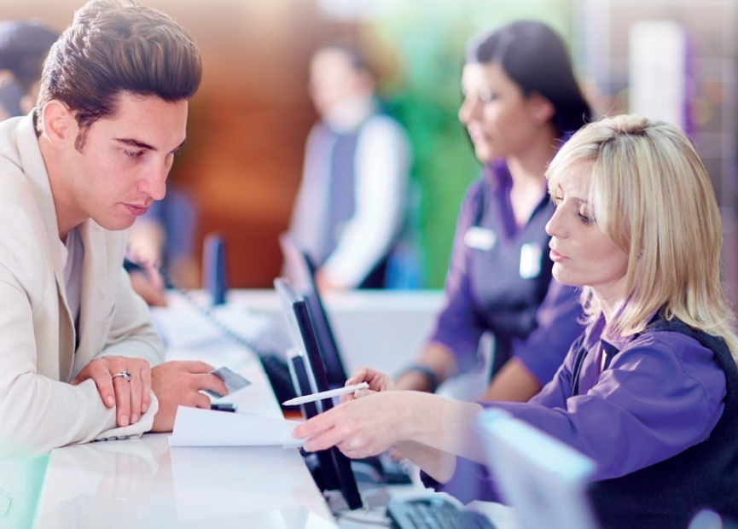
Paulo is talking to a clerk.
What are they talking about?

Slide 3
0 1 2 3 4 5 6 7 8 9 10

Slide 4
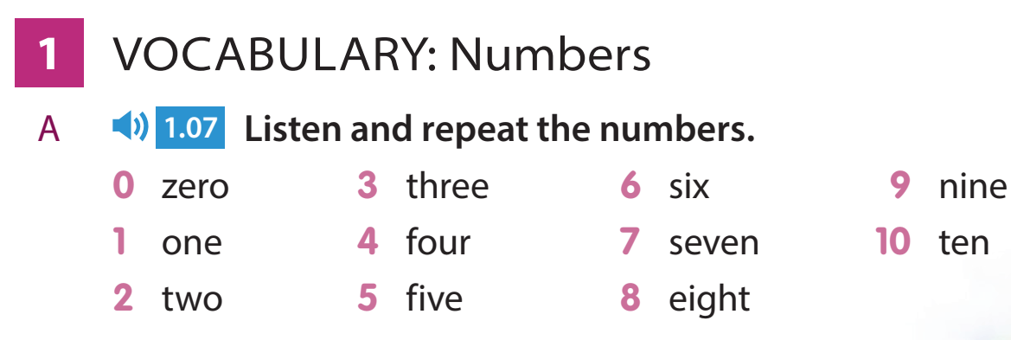

Slide 7
Ask each other these questions. What’s your name? What city are you from? What’s your cell phone number? What is the room number? (perhaps the number of your classroom) What is your email address?

Slide 35
Name some hotels in the city you live in.

Slide 36
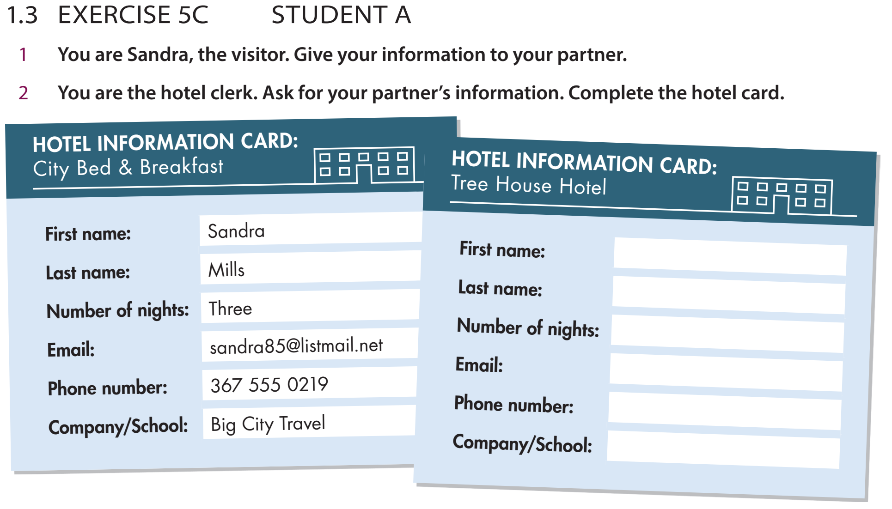
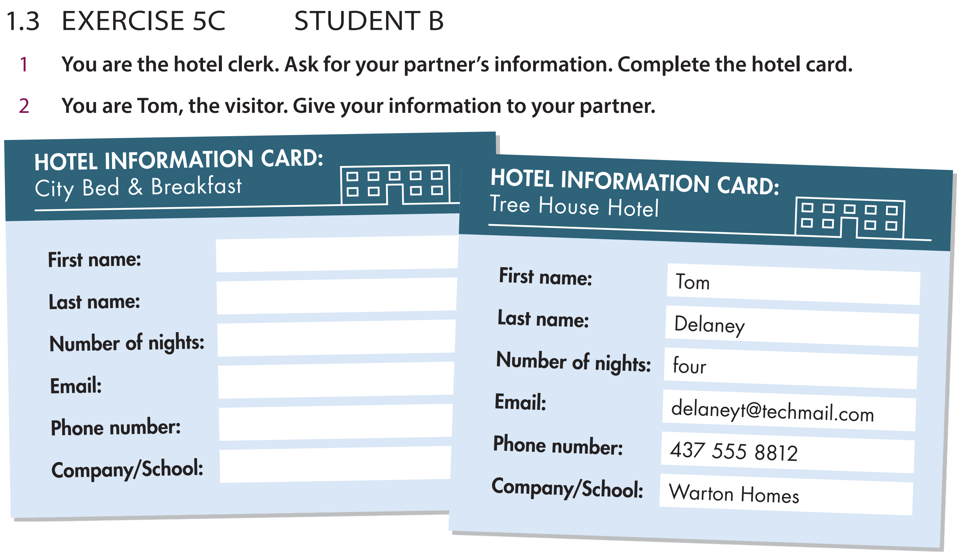
156
158

