Slide 1
Evolve 1A 2.1

Slide 2
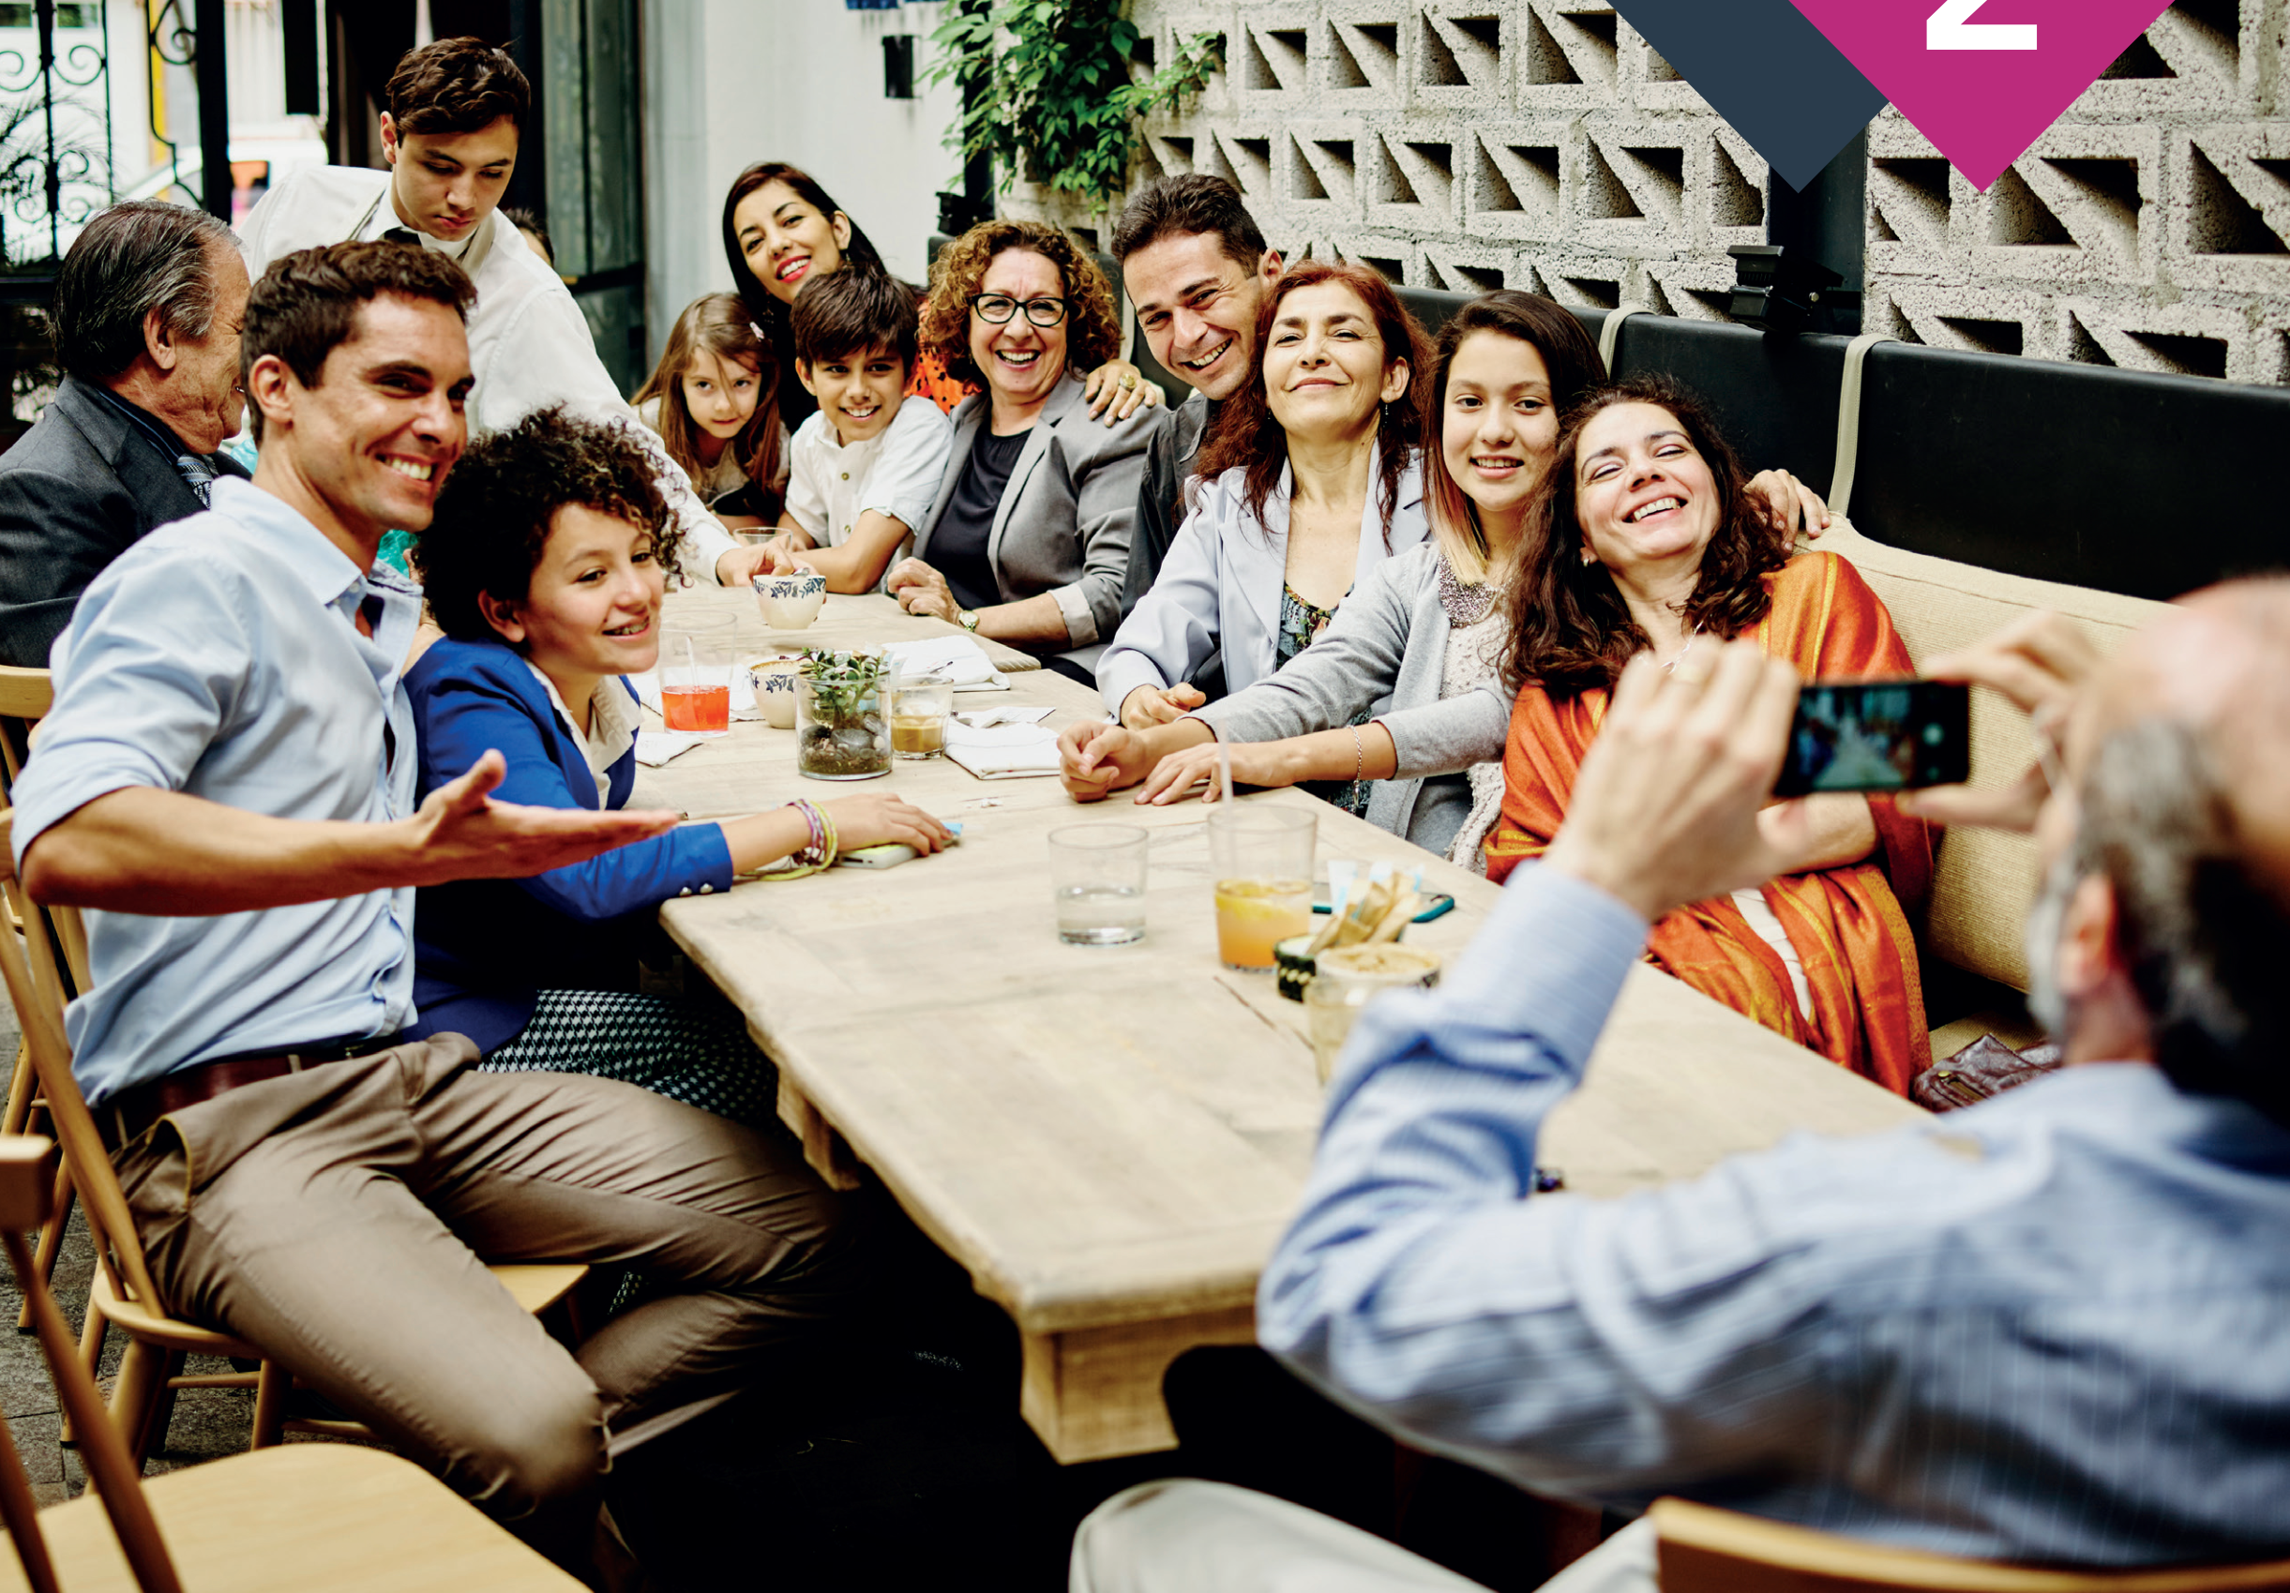

Slide 3
What family members can you hear in the conversation?

Slide 4
What family members can you hear in the conversation?

Slide 5
What family members can you hear in the conversation?

Slide 9
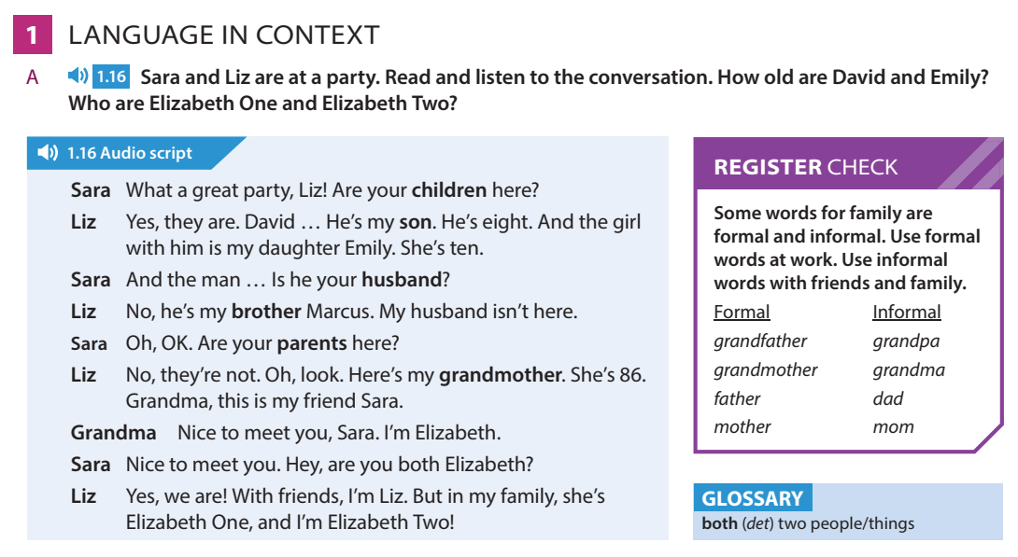

Slide 13
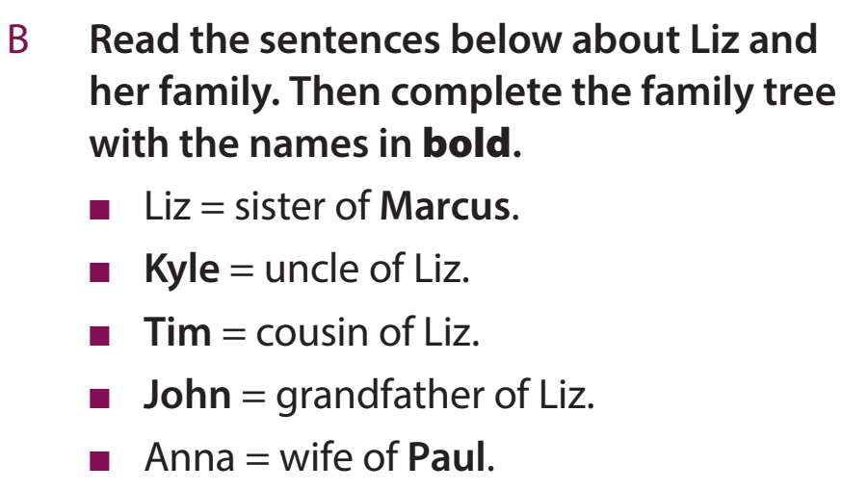
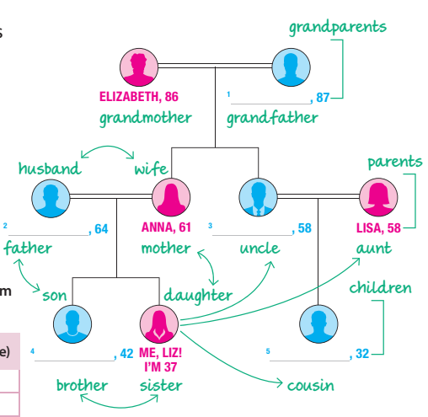

Slide 15
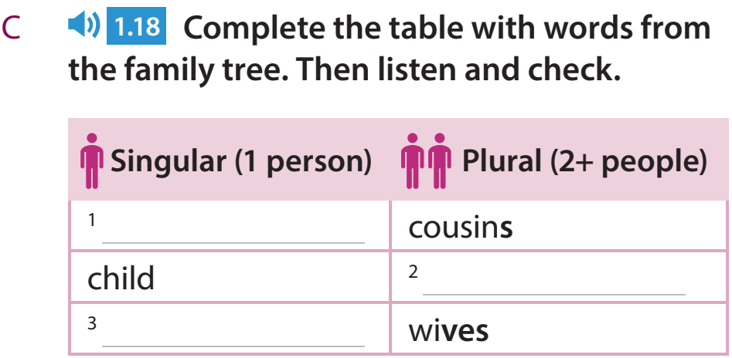

Slide 18
For example: Lisa is aunt of Liz. She is a teacher

Slide 19
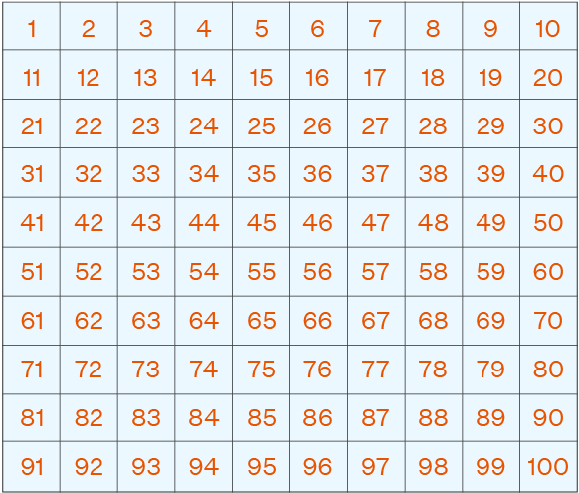

Slide 23
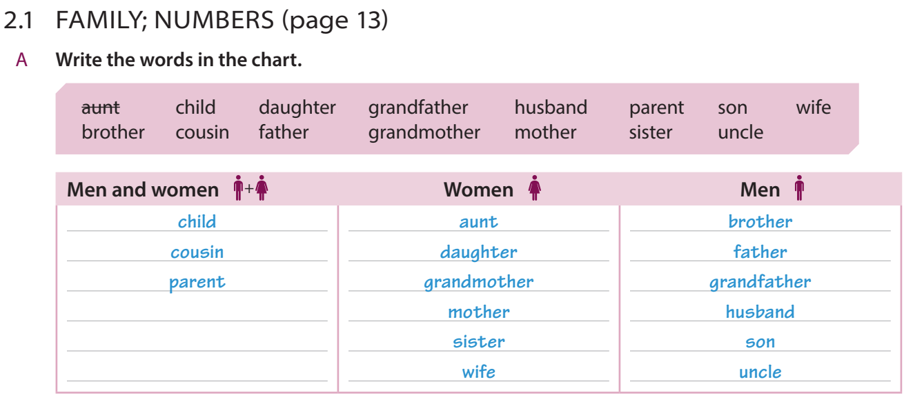

Slide 27
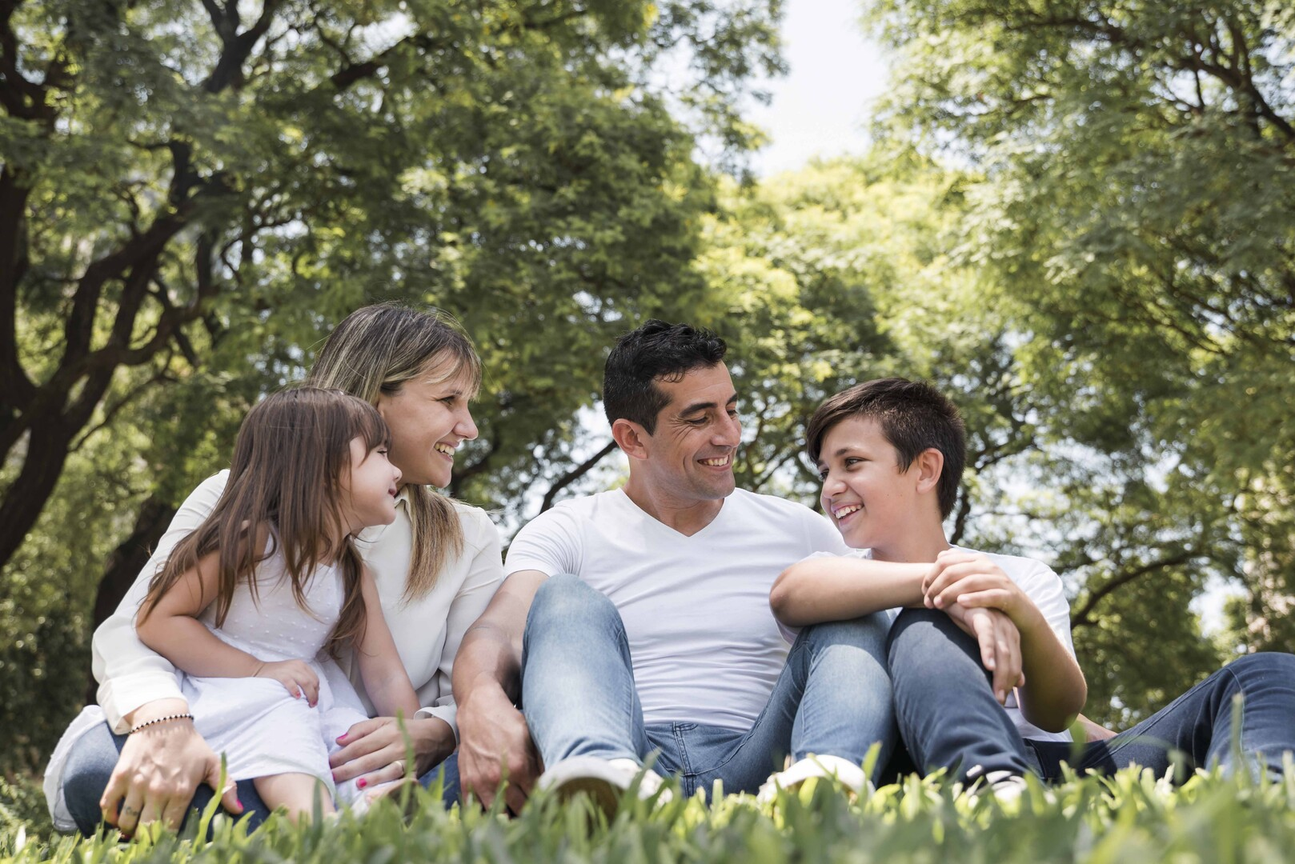

Slide 28
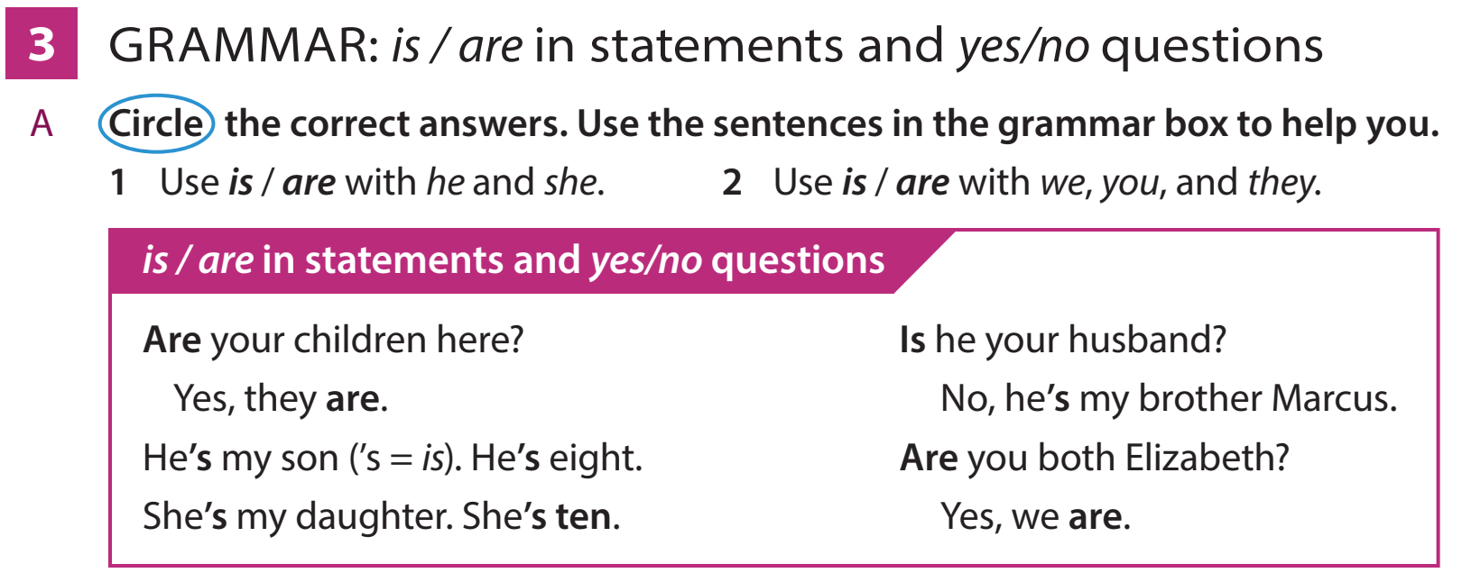

Slide 29
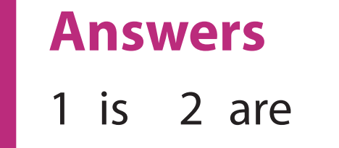

Slide 40
Is your family tree the same or different ?

