Slide 1
Evolve 1A 2.2

Slide 2
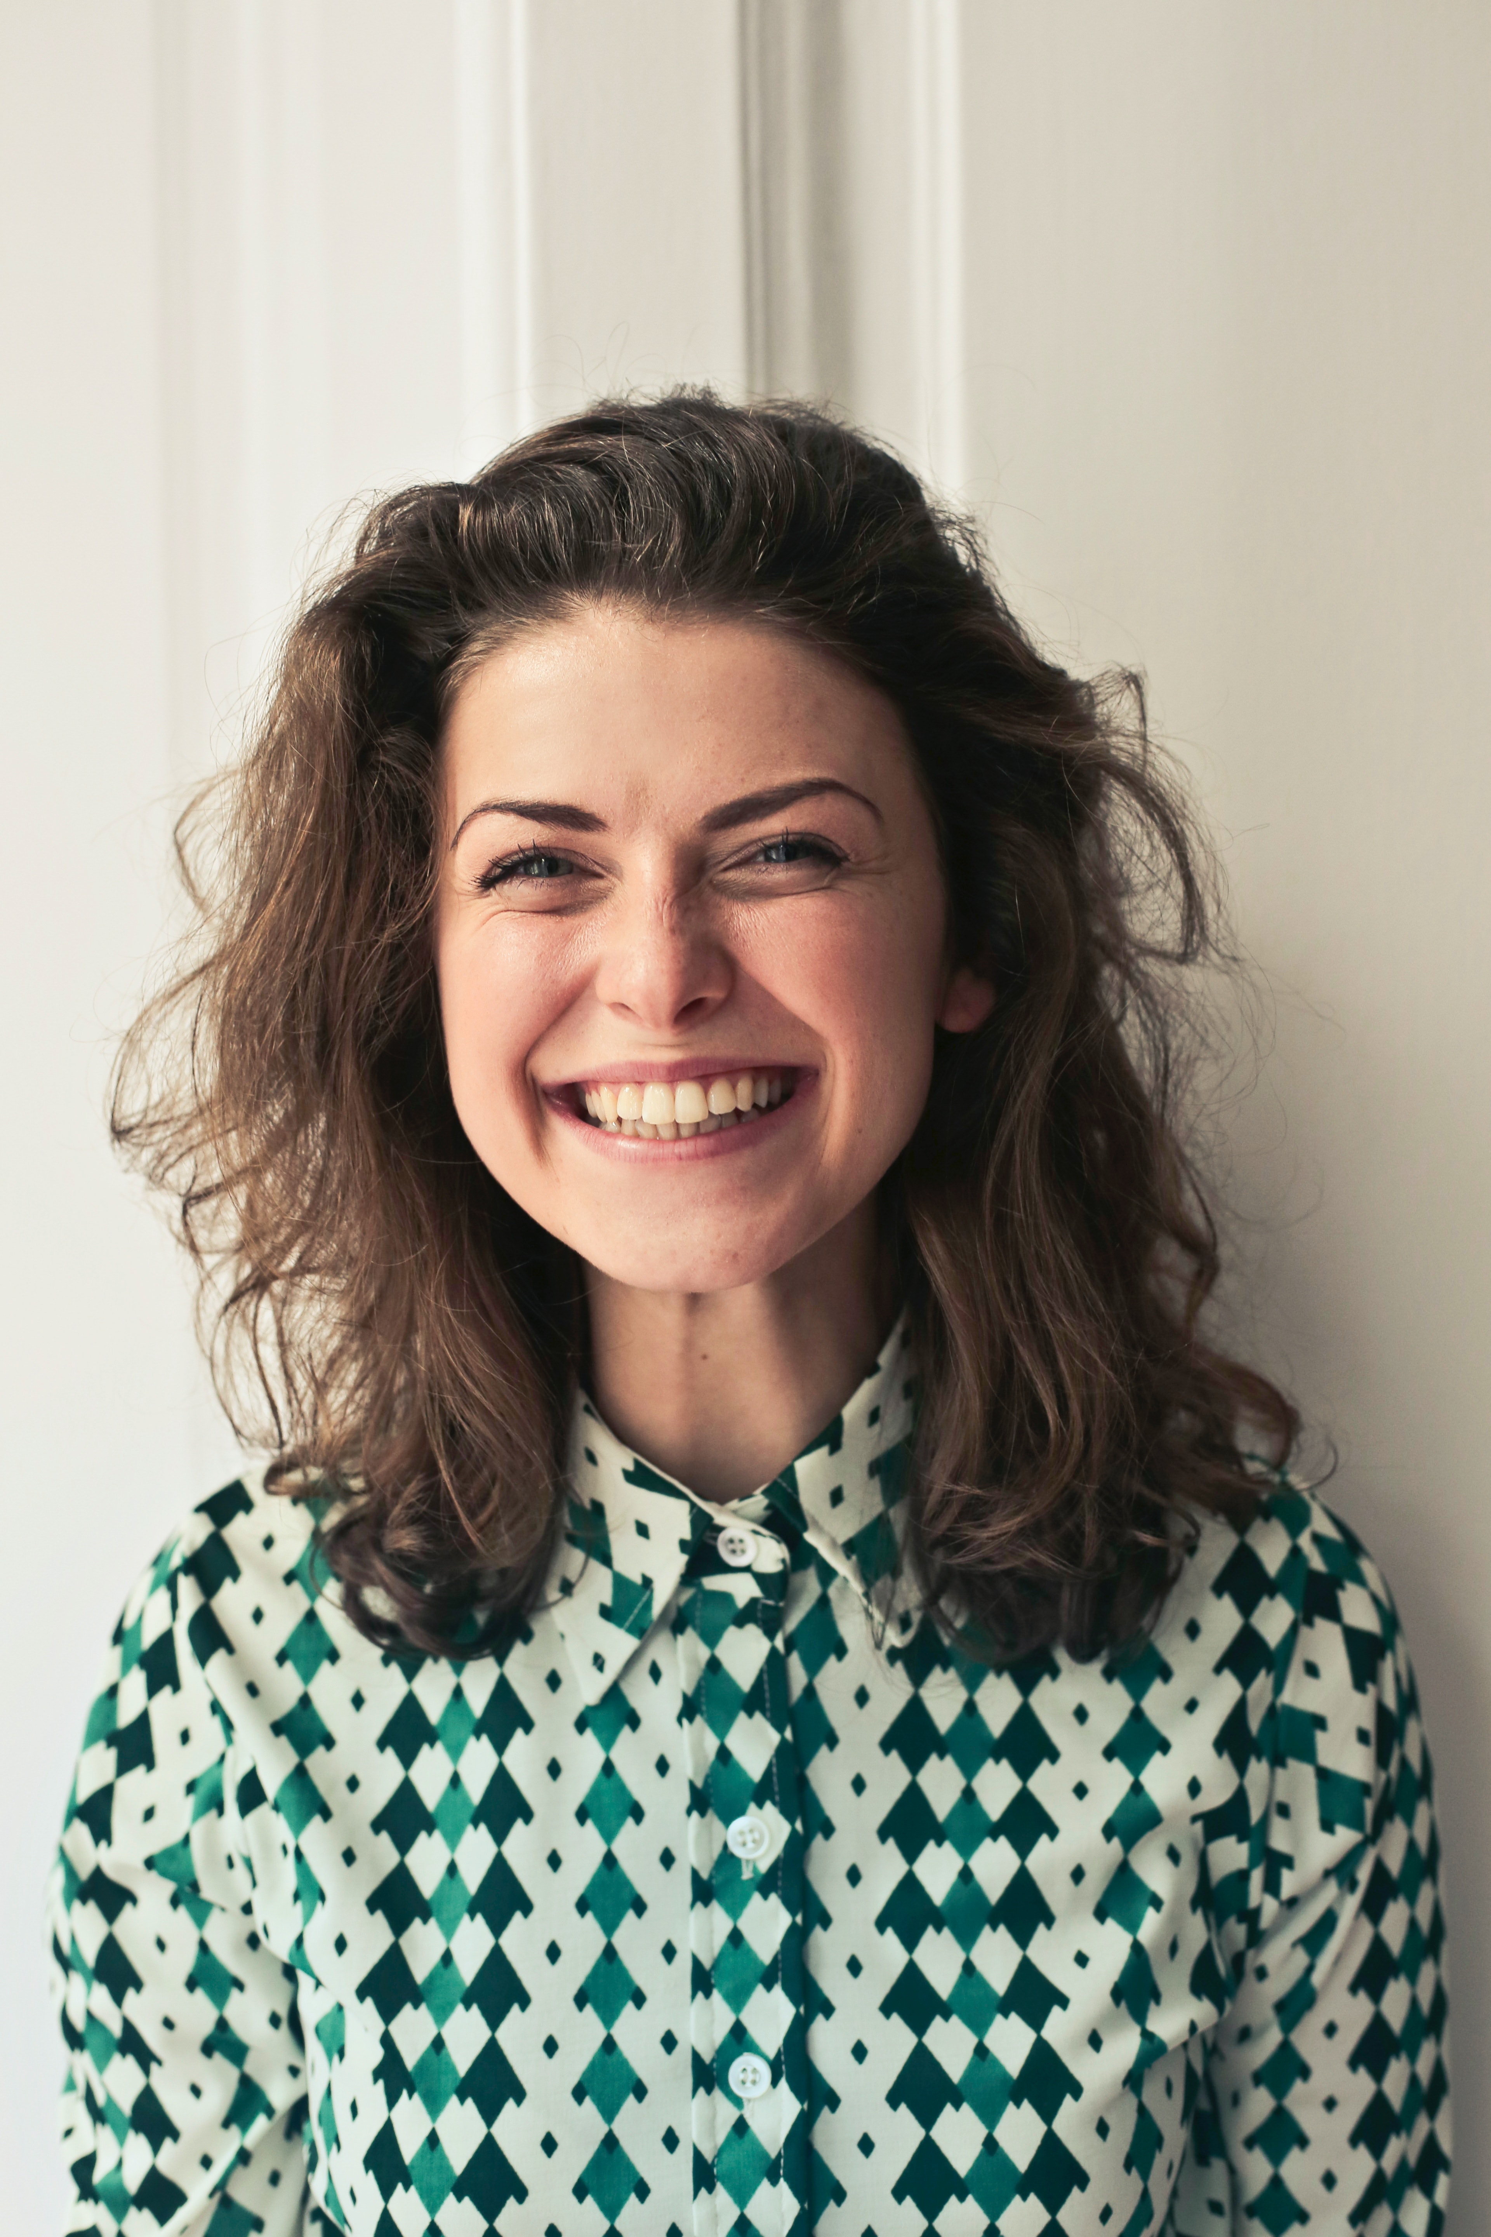

Slide 7
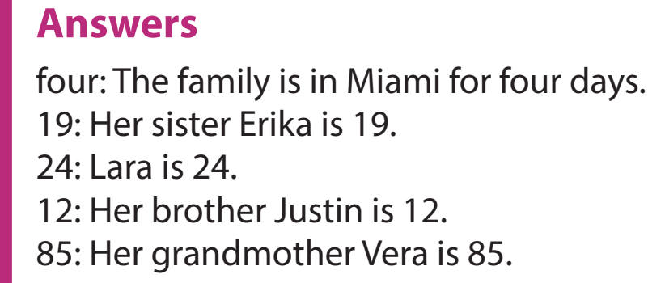

Slide 8
She is friendly . She is short . She is Young .

Slide 11
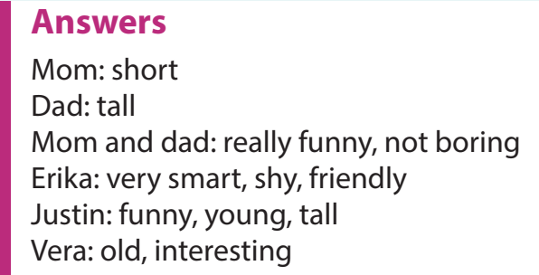

Slide 16
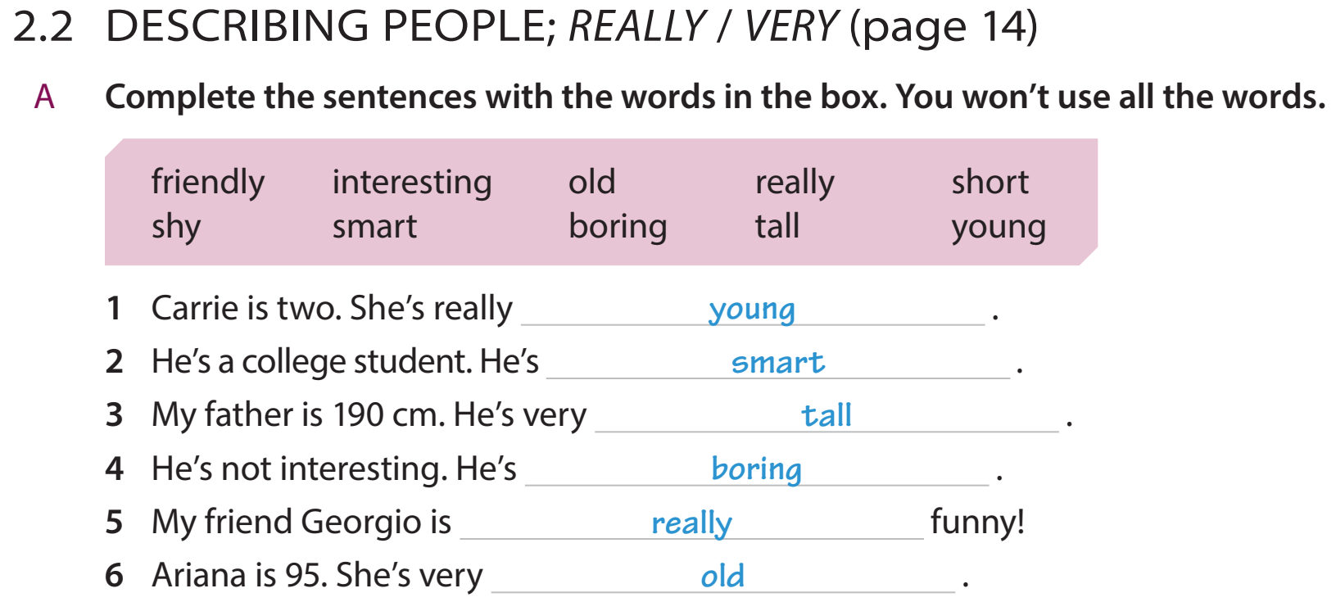

Slide 22
Simon ____ interesting. She ____ boring. Maria and Jose ___ from Argentina. We ____ old.
Fill in the gap.

Slide 23
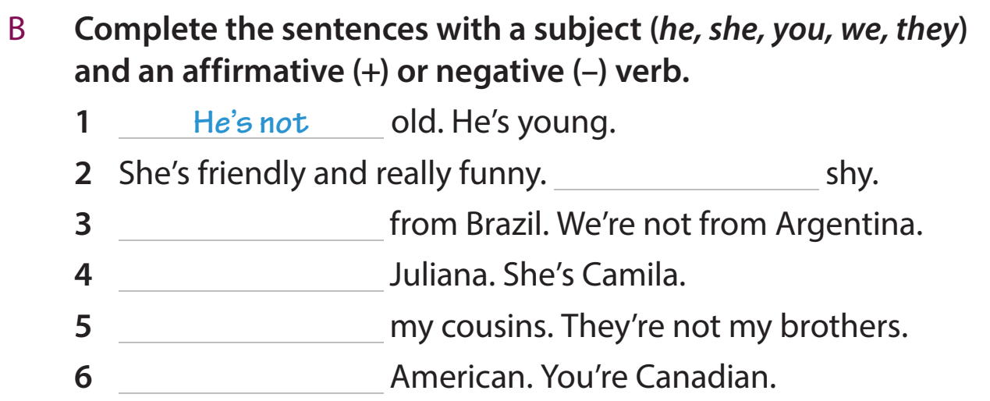

Slide 25
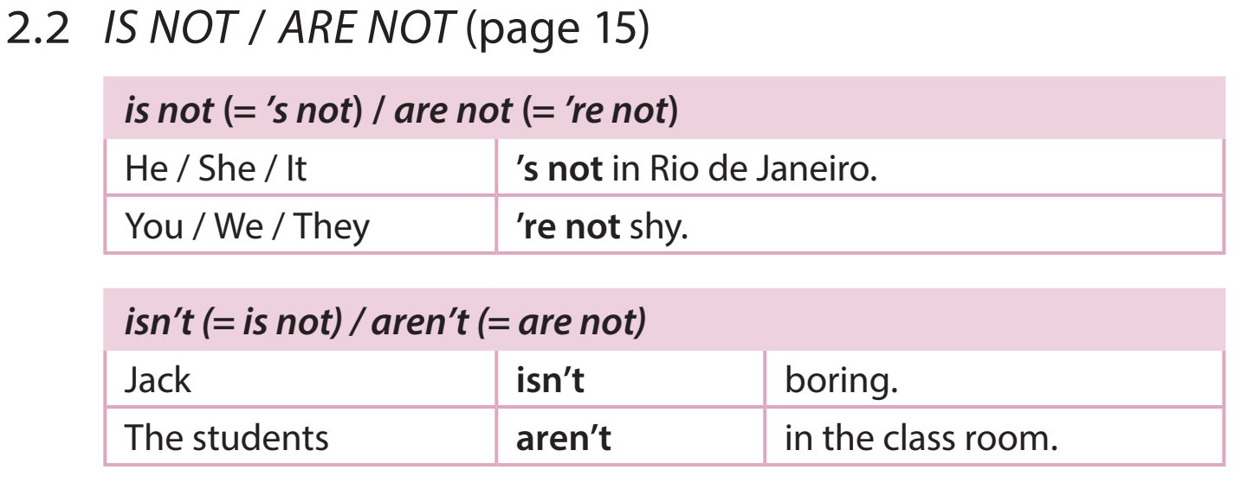

Slide 31
Are your family or friends the same as Larissa’s?

Slide 32
