Slide 1
Evolve 1B 7.5

Slide 2
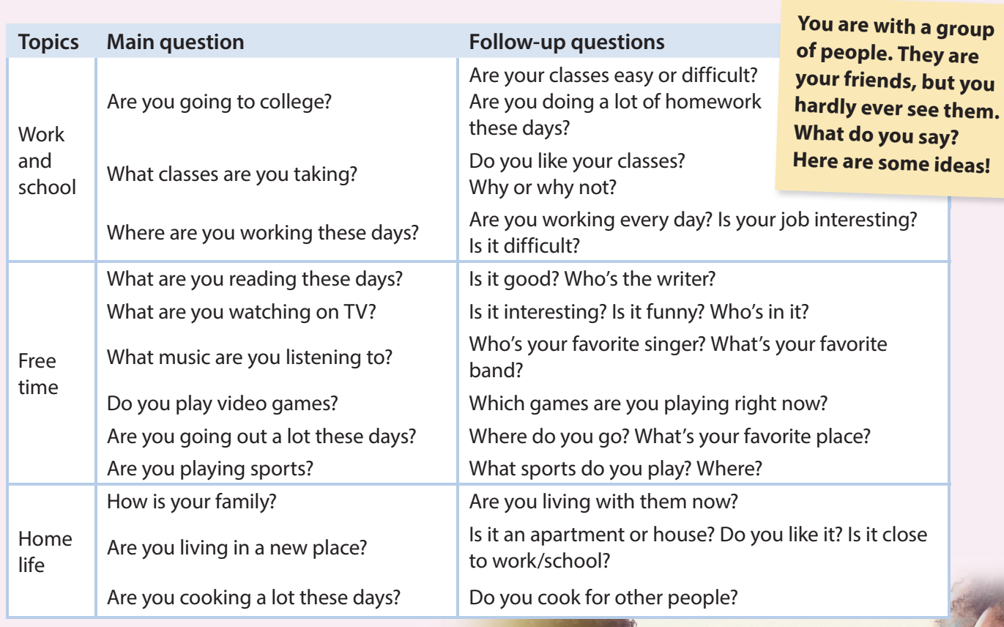

Slide 5
