Slide 1
Evolve 1C 9.3

Slide 6
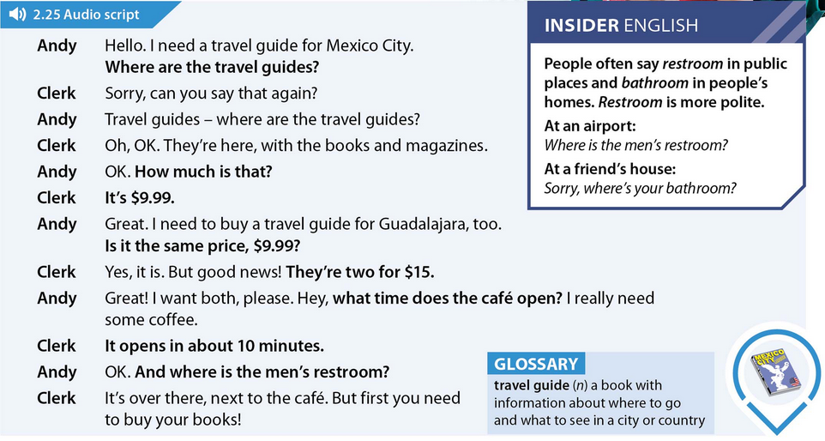

Slide 12
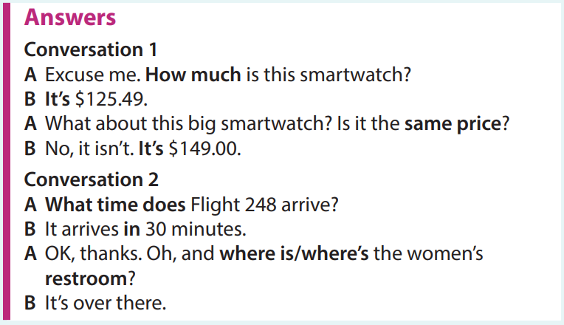

Slide 23
