Slide 1
Evolve 1C 12.5

Slide 3
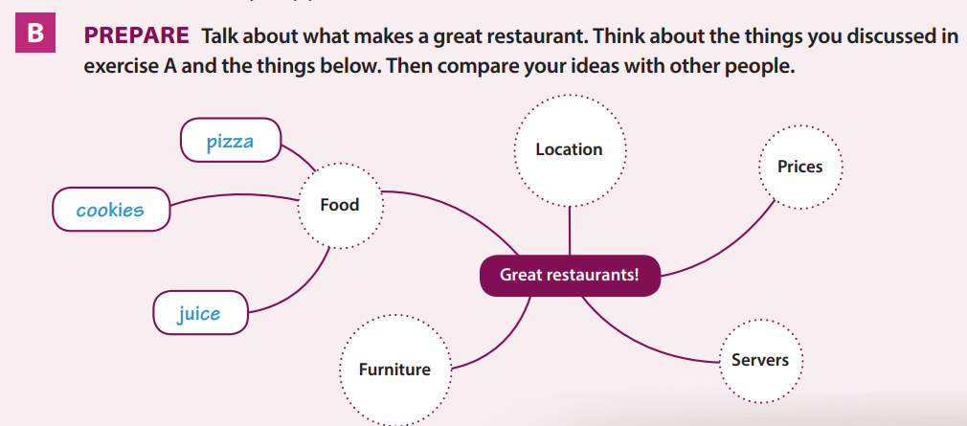

Slide 4
