Slide 1
Evolve 2C 9.1

Slide 11
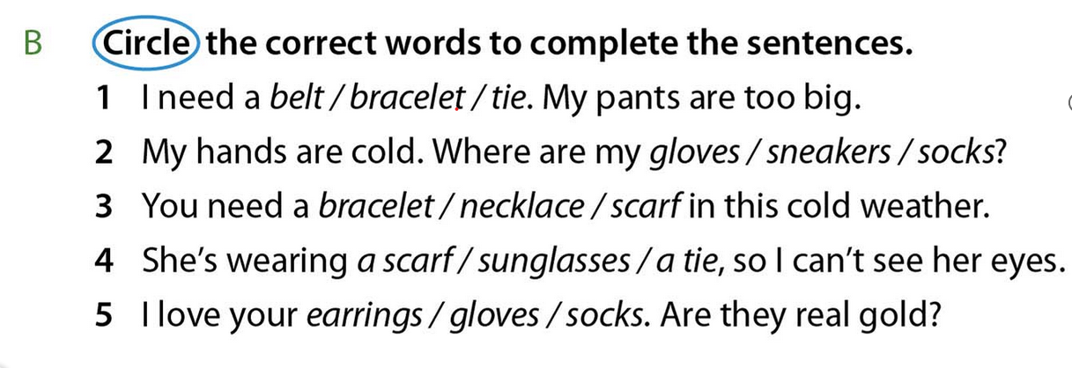

Slide 17
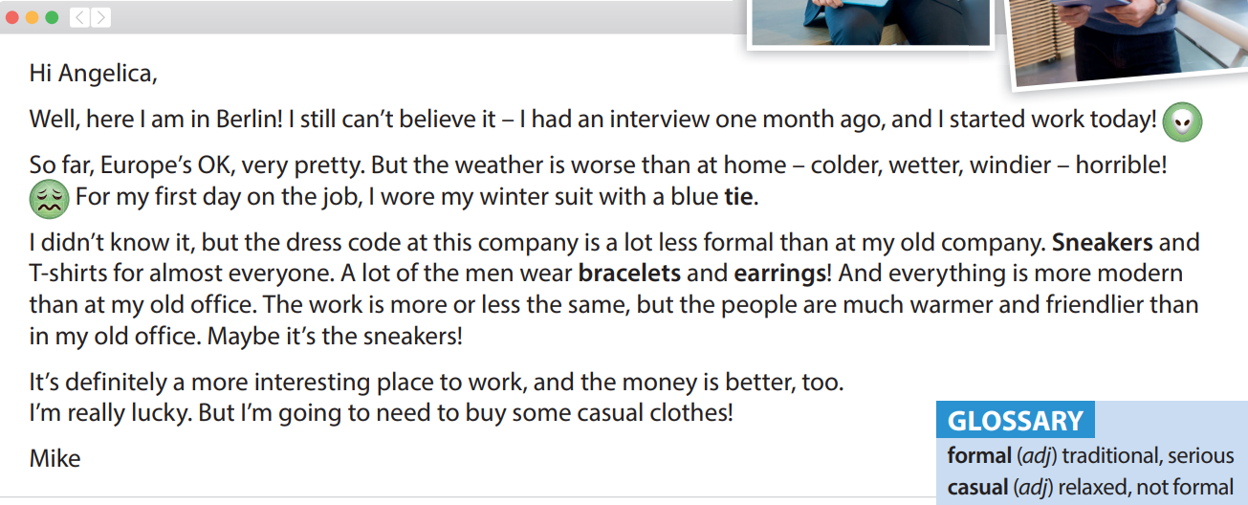

Slide 24
