Slide 1
Evolve 2C 9.4

Slide 5
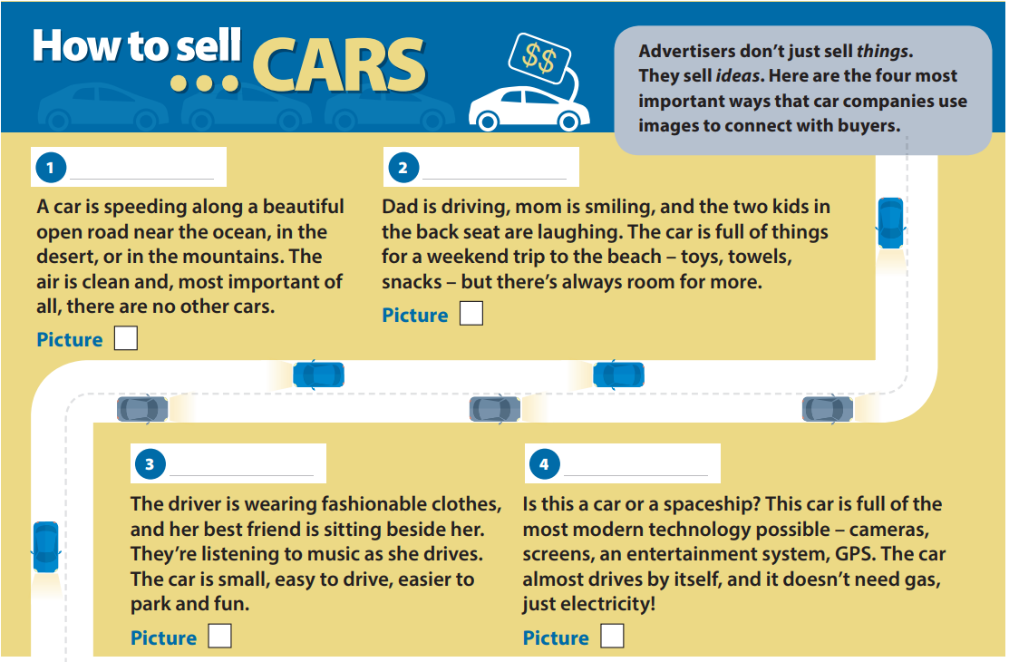

Slide 12
