Slide 1
Evolve 2C 10.3

Slide 4
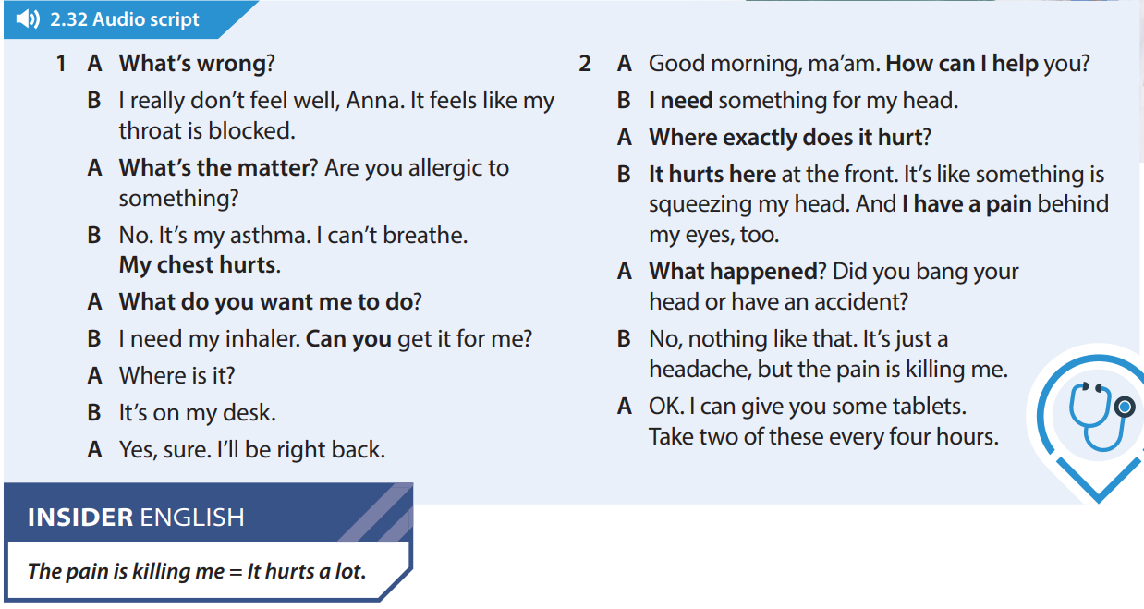

Slide 7
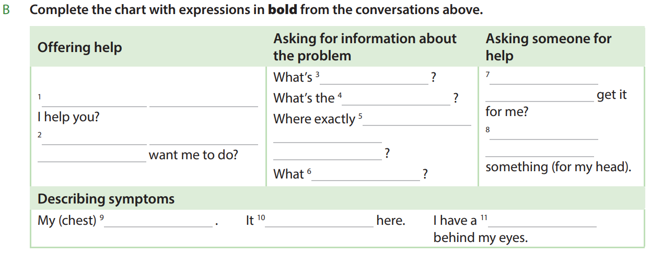

Slide 9
