Slide 1
Evolve 2C 11.1

Slide 21
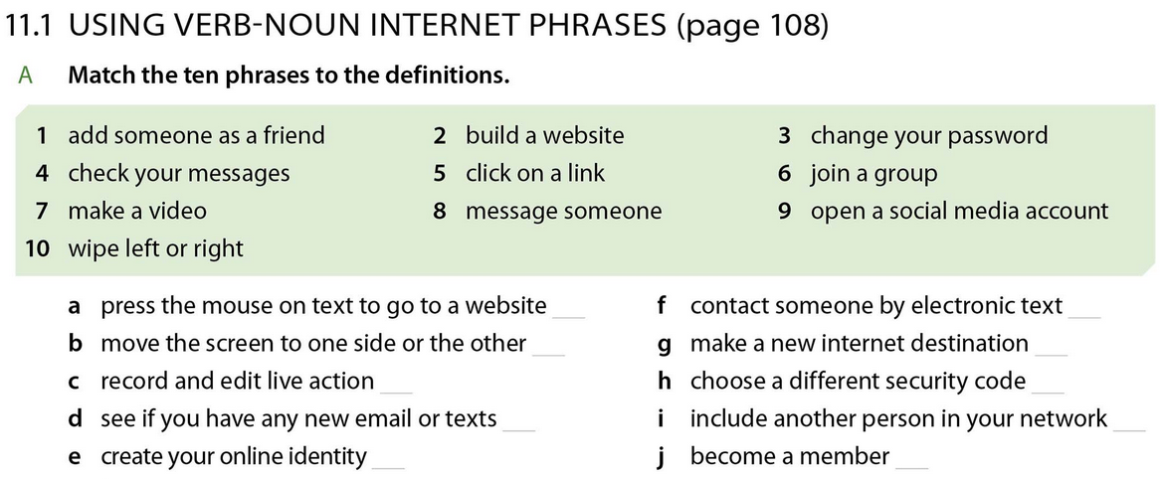

Slide 22
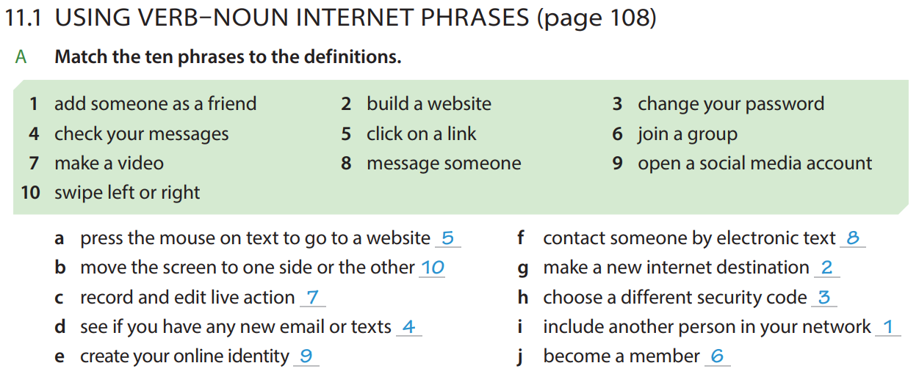

Slide 30
