Slide 1
Evolve 2C 11.2

Slide 8
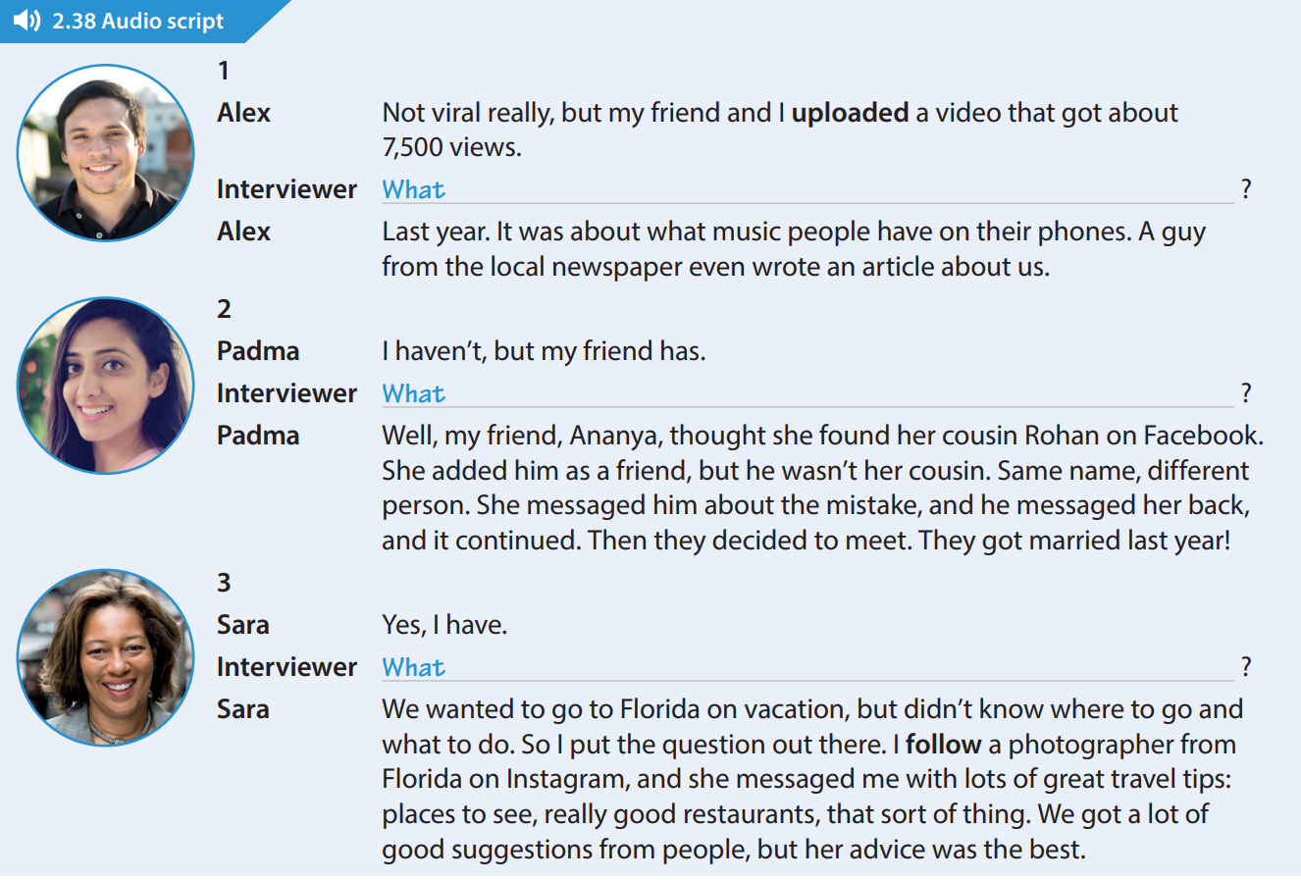

Slide 13
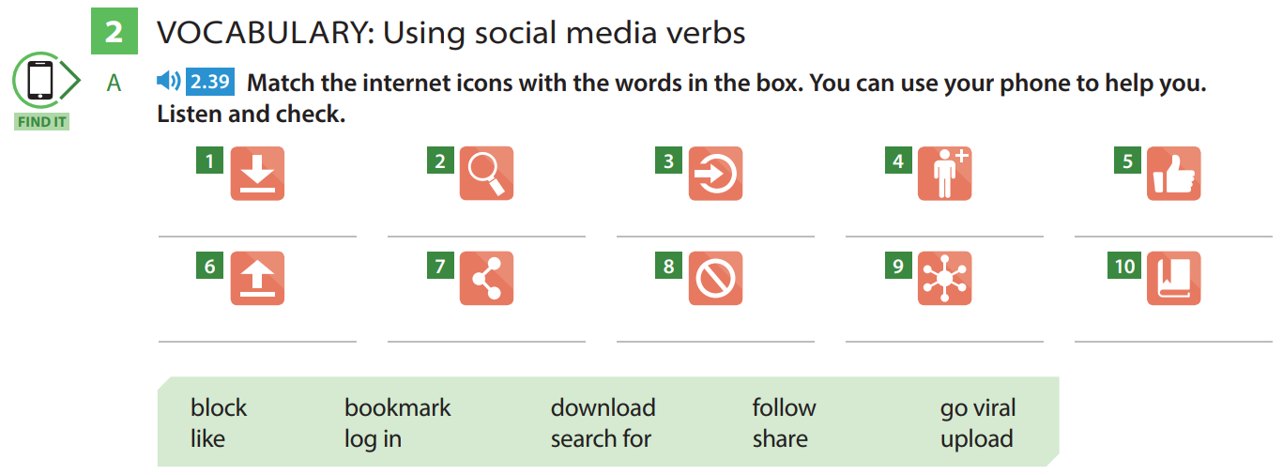

Slide 22
