Slide 1
Evolve 2C 11.5

Slide 6
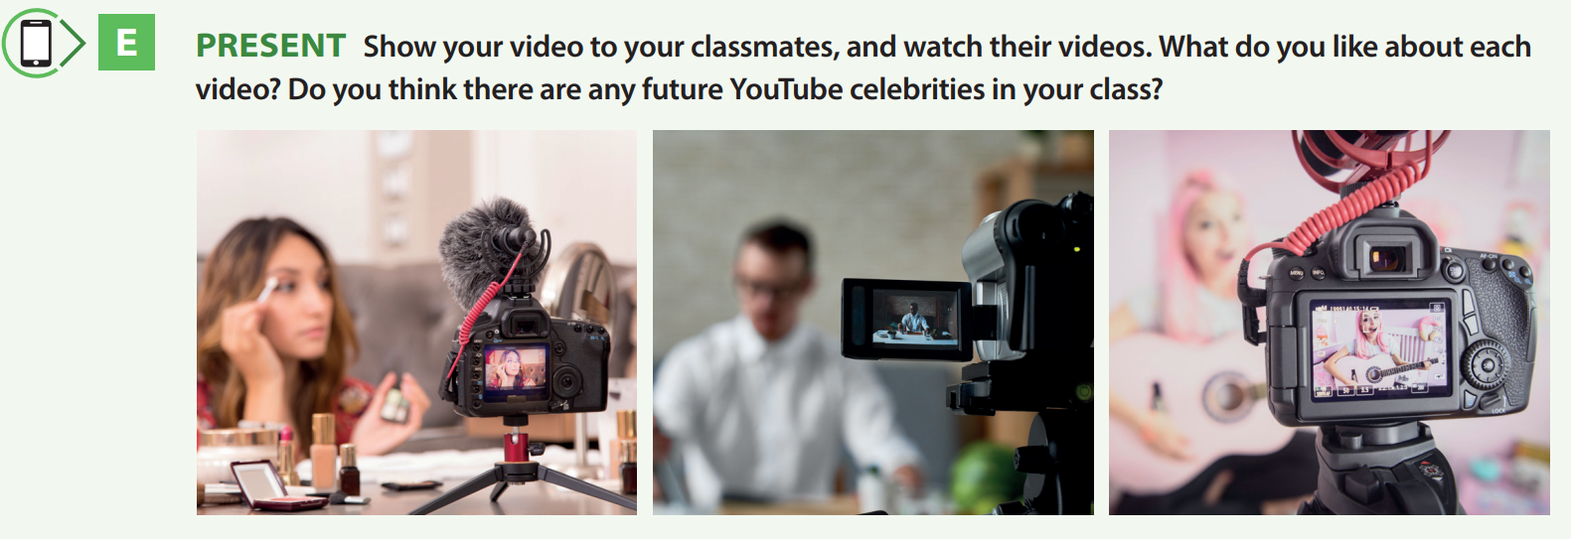

Slide 7
