Slide 1
Evolve 2C 12.1

Slide 12
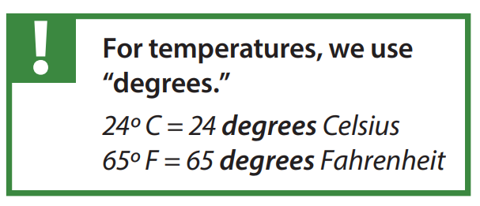

Slide 29
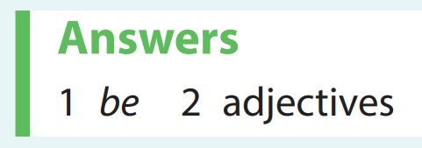

Slide 31
