Slide 1
Evolve 2C 12.3

Slide 9
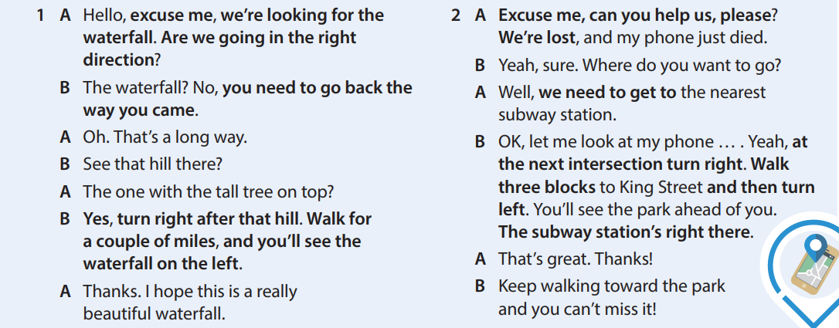

Slide 22
