Slide 1
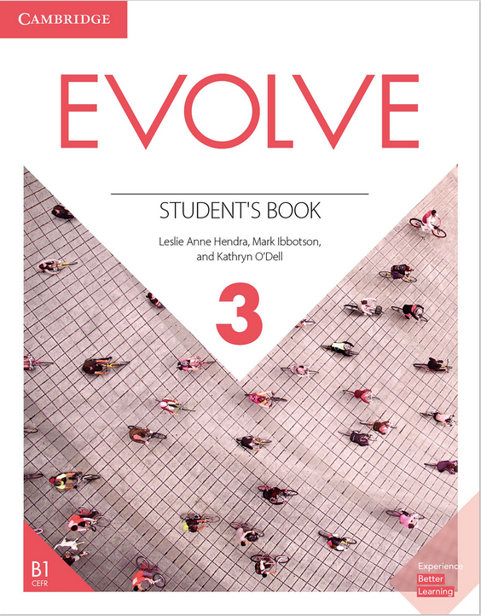
Evolve 3A 1.1

Slide 3
Share your partner’s answers with the class

Slide 5
Share your answers with the class
and explain your answers

Slide 8
Do you have the same ideas as Andres?

Slide 10
Are you good at knowing someone’s personality after meeting them for the first time?

Slide 12
Share your partner’s answers with the class.

Slide 13
Student’s Ideas
1-
2-
3-
.
.
.

Slide 14
Cover the article except for the title.

Slide 15
Any guesses? Volunteer?

Slide 16
• Uncover the article and read it silently to yourself.
• Go over any unfamiliar vocabulary.

Slide 17
What is an example of a question a sociable/selfish/generous/helpful person
might ask?

Slide 18
Did anyone guess the correct answer?
What kinds of questions do you ask someone when you meet them for the first time?

Slide 19
Share your partner’s ideas with the class.

Slide 20
Cover the box with the vocabulary words and then look at the pictures.

Slide 21
Think of adjectives that describe the people in the pictures.

Slide 26
Explain what in the picture gave them the answer.

Slide 27
Share your answers with the class.

Slide 28
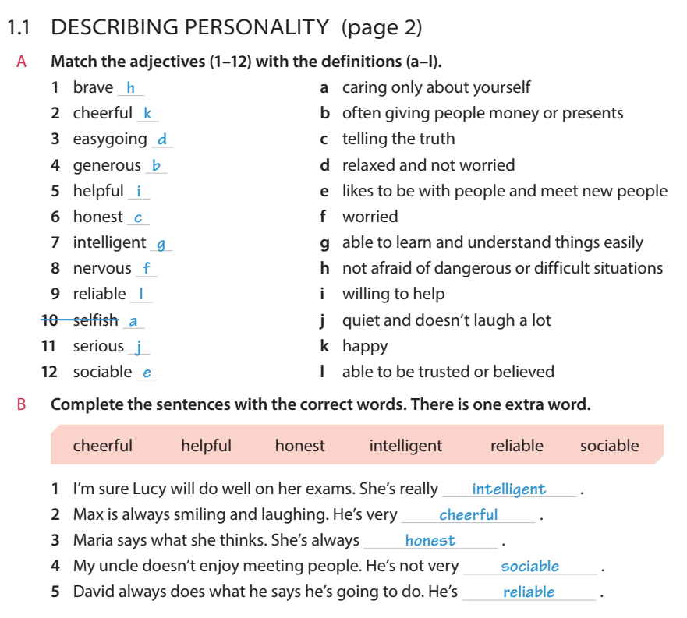

Slide 35
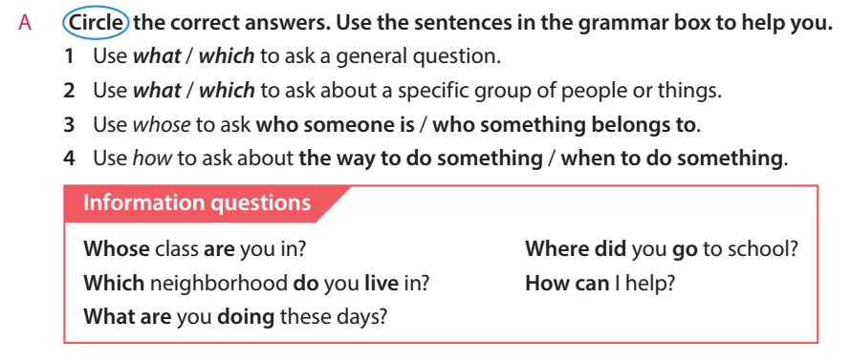
Read the information in the grammar box silently to yourselves.

Slide 37
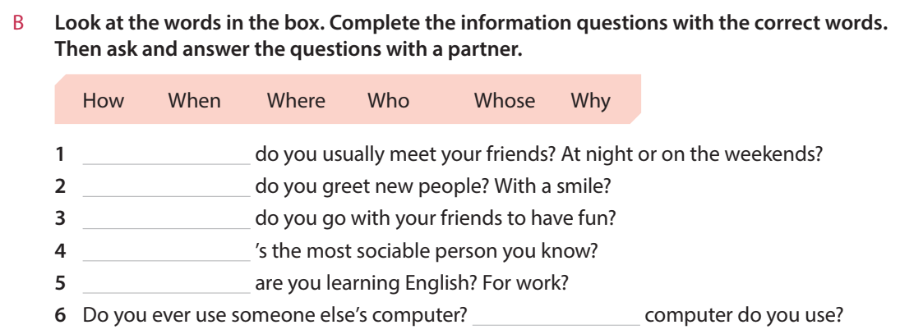

Slide 39
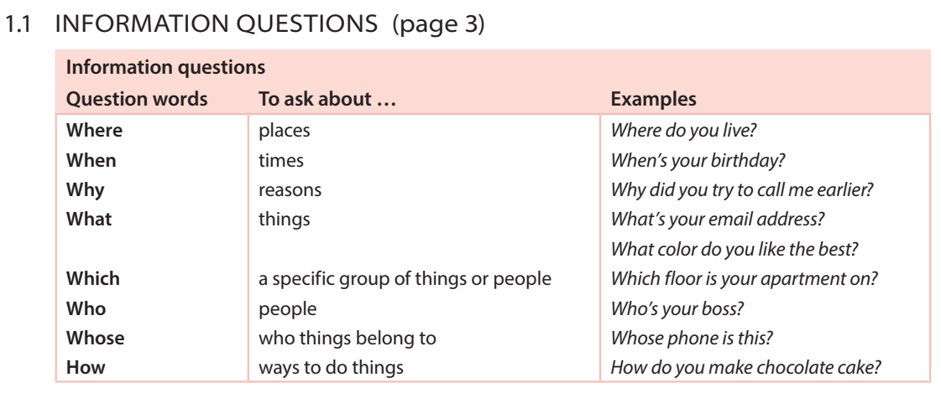

Slide 40
Do the grammar exercise for 1.1.

Slide 41
Do the grammar exercise for 1.1.

Slide 42
Which question word will they use for the first question?
What tense will the question be in?

Slide 43
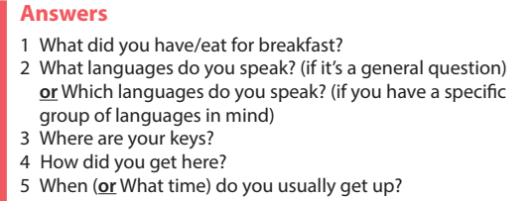

Slide 44
Take turns asking and answering the questions in exercise 3D using your own information.
Share your partner’s answers with the class.

Slide 45
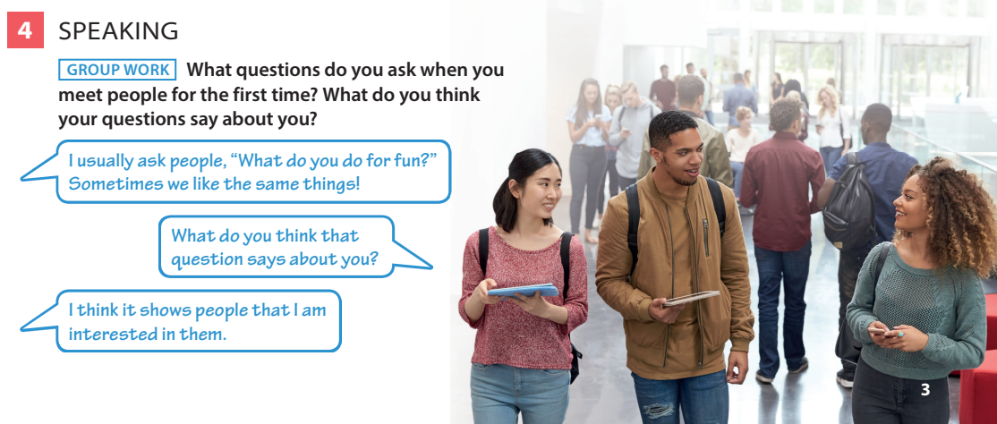
One Student from each group reports their group’s discussion to the class.

