Slide 1
Evolve 3A 3.5

Slide 2
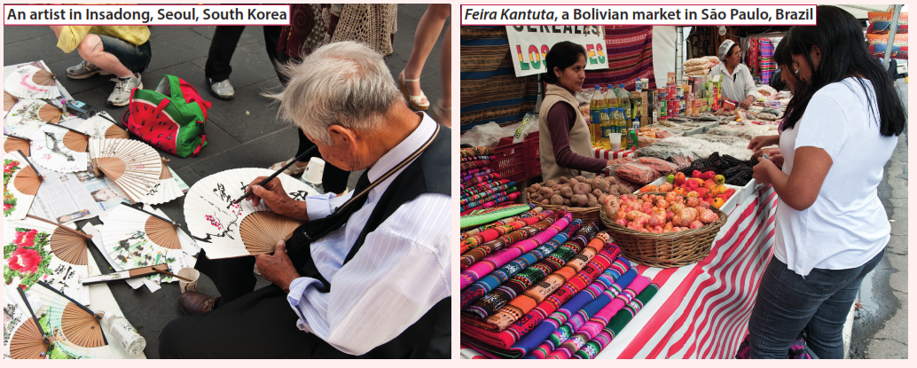

Slide 7
