Slide 1
Evolve 3A 4.2

Slide 2
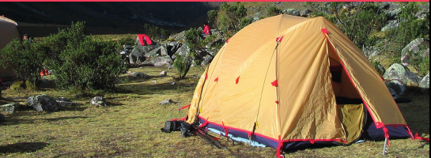

Slide 3
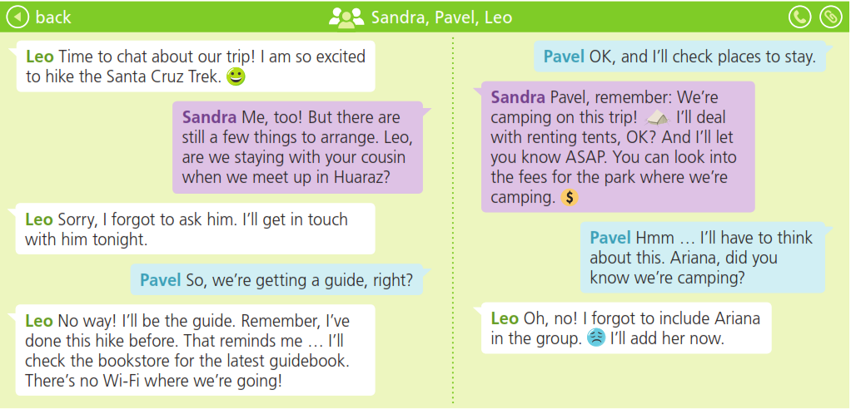

Slide 5
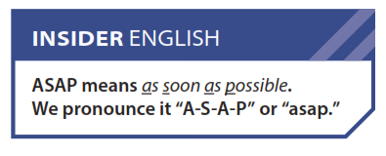

Slide 9
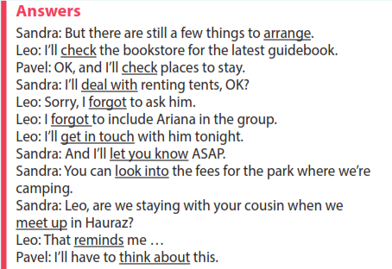

Slide 10
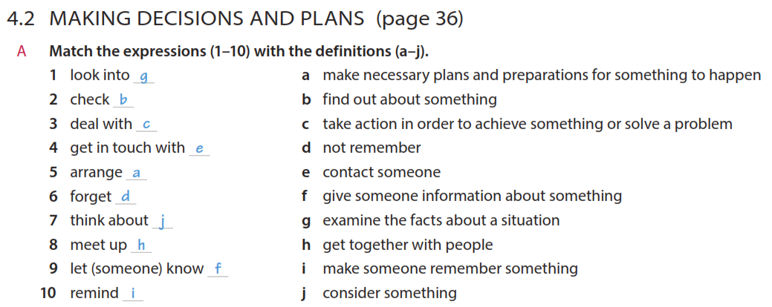

Slide 12
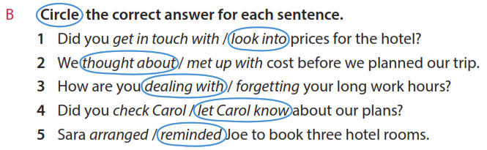
look into
though about
dealing with
/ let Carol know
reminded

Slide 21
I’ll pay
He’s driving
I’ll book
We’re meeting up
I’m taking
I’ll check

Slide 27
