Slide 1
Evolve 3B 7.5

Slide 3
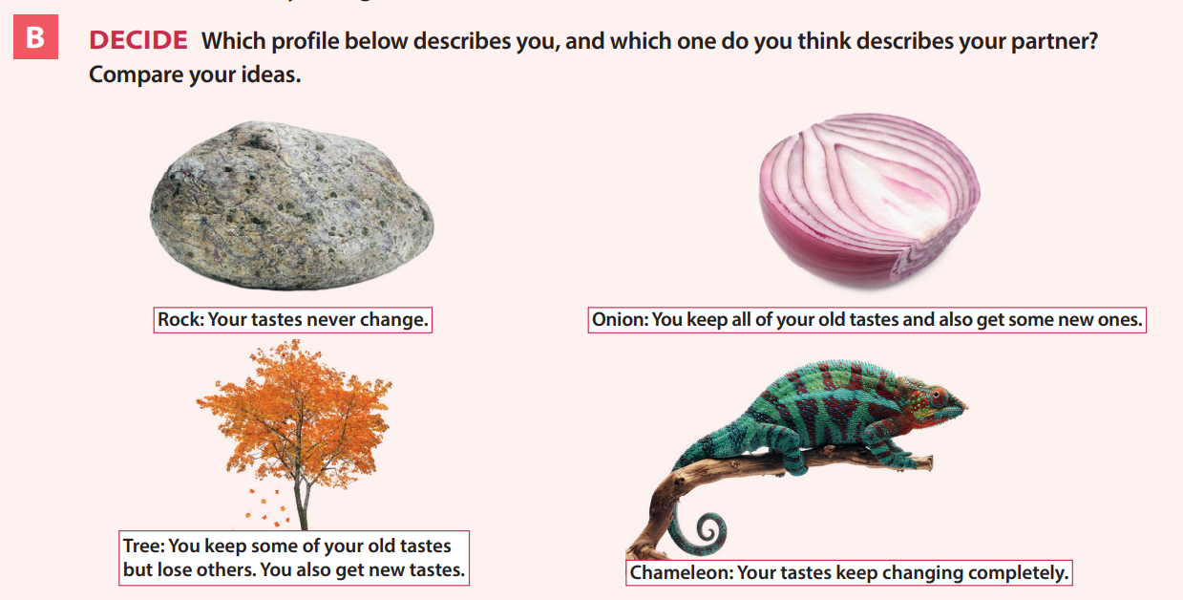

Slide 7
