Slide 1
Evolve 3C 9.3

Slide 10
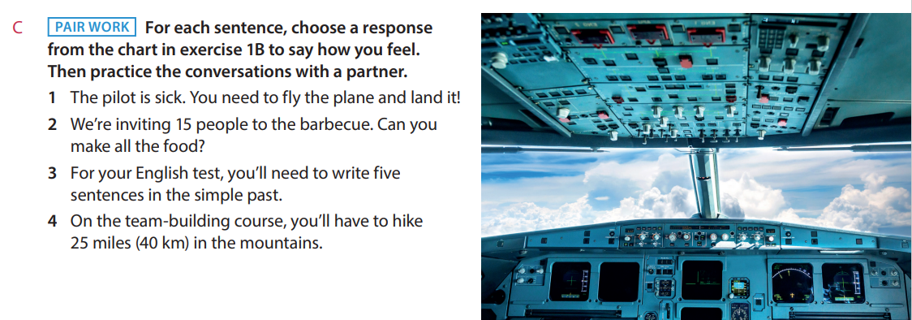

Slide 23
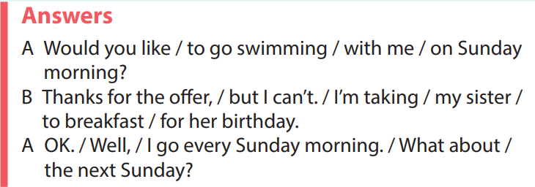

Slide 26
A picture is worth a thousand words

