Slide 1
Evolve 3C 10.3

Slide 4
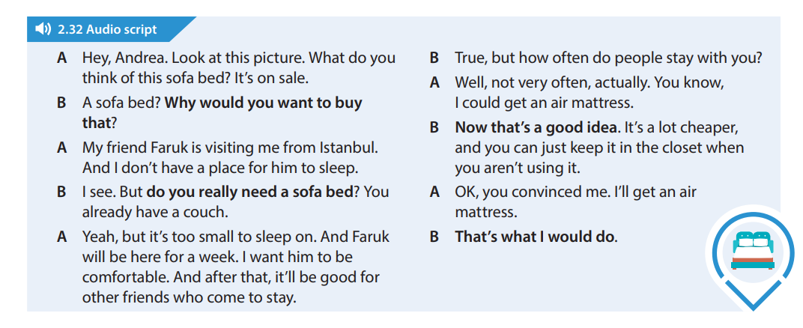

Slide 23
