Slide 1
Evolve 3C 11.1

Slide 7
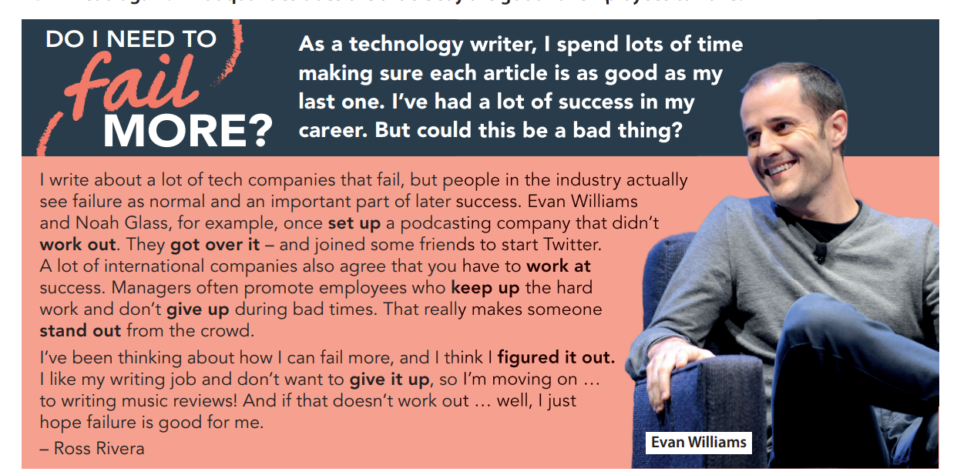

Slide 15
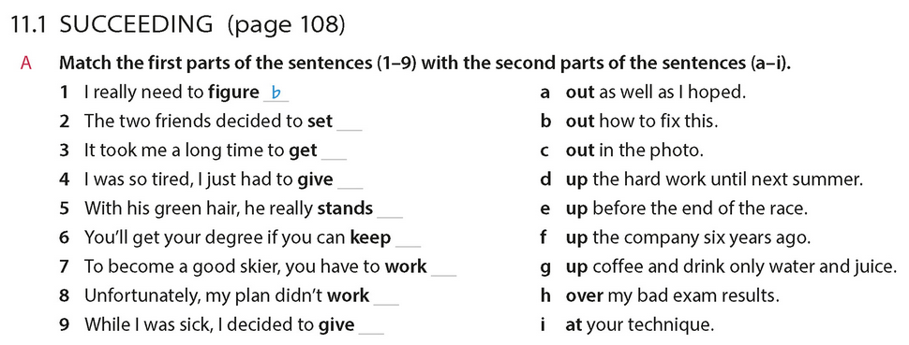

Slide 22
