Slide 1
Evolve 3C 11.4

Slide 7
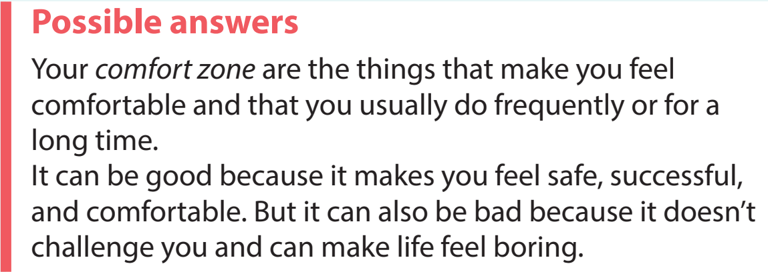

Slide 12
