Slide 1
Evolve 4B 5.4

Slide 11
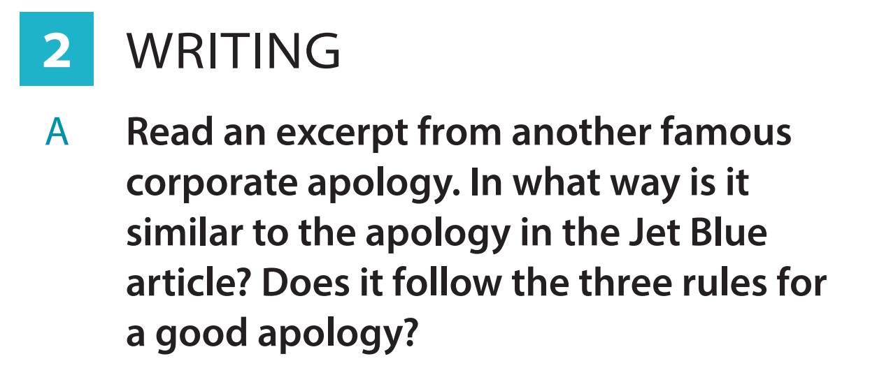

Slide 13
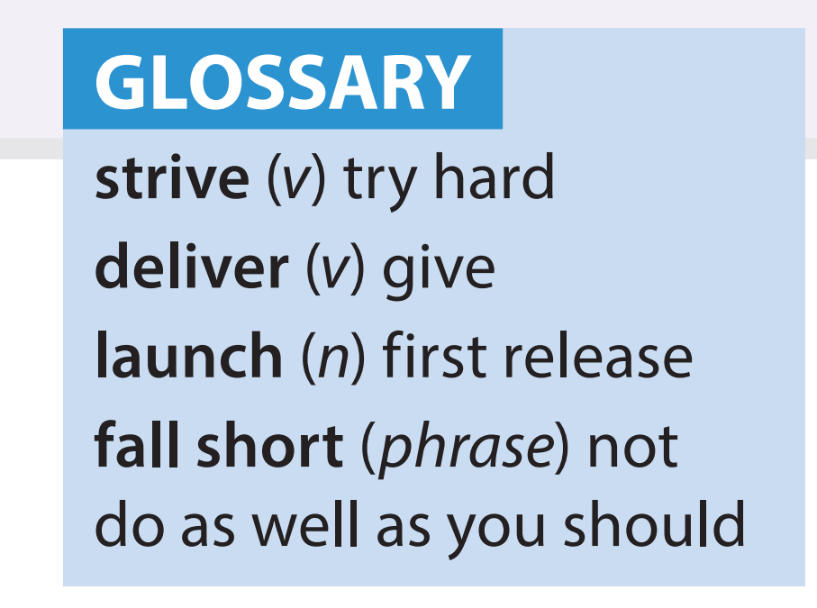

Slide 15
