Slide 1
Evolve 4B 5.5

Slide 5
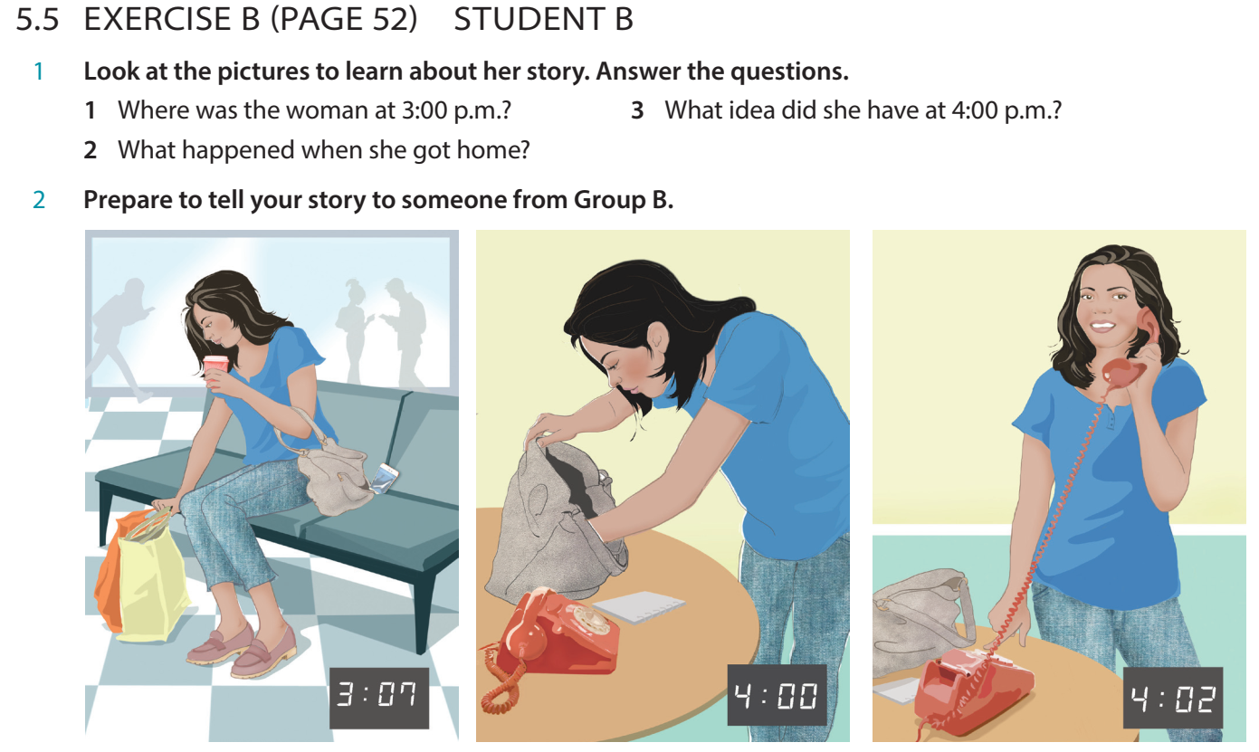

Slide 10
