Slide 1
Evolve 4B 6.3

Slide 5
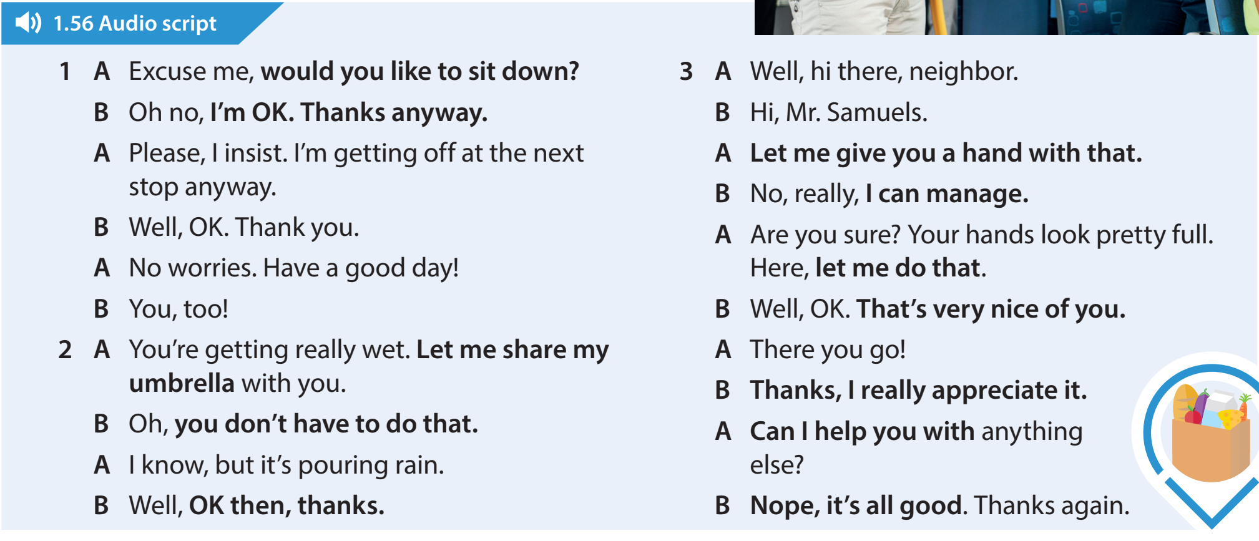

Slide 10
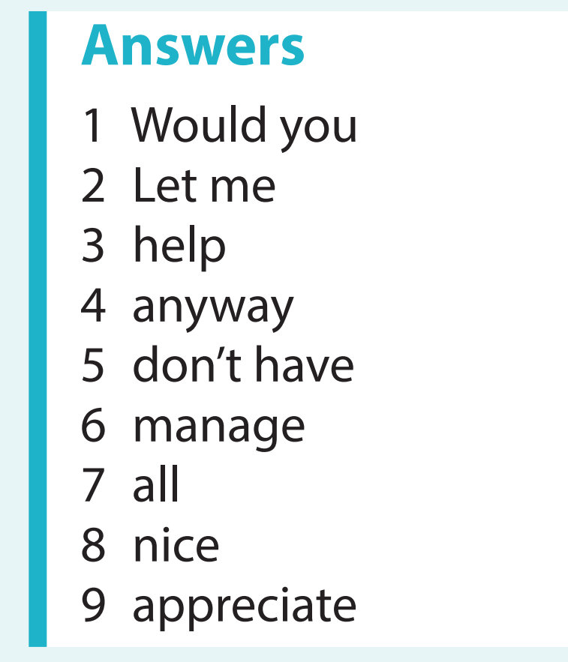

Slide 14
