Slide 1
Evolve 4B 7.5

Slide 4
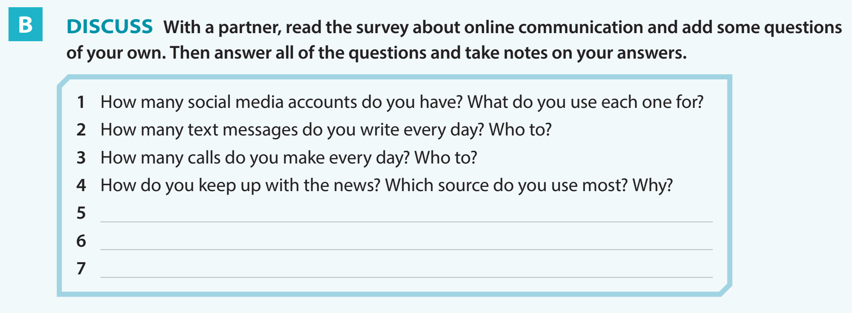

Slide 7
