Slide 1
Evolve 4C 9.4

Slide 2
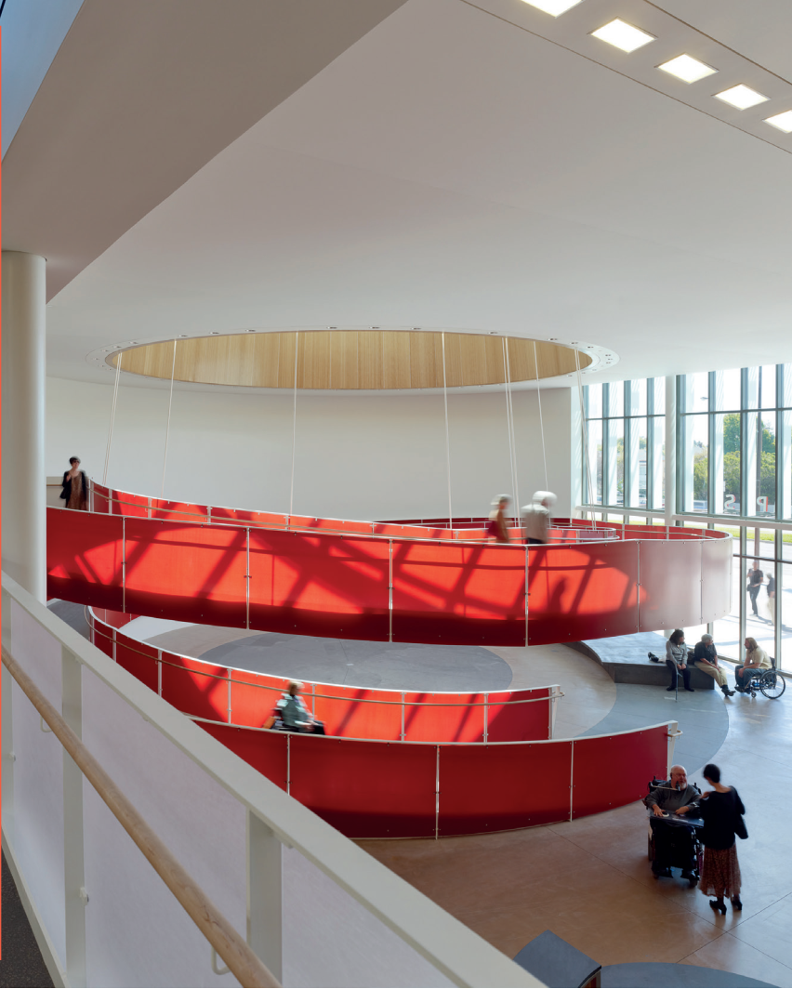

Slide 15
