Slide 1
Evolve 4C 10.3

Slide 5
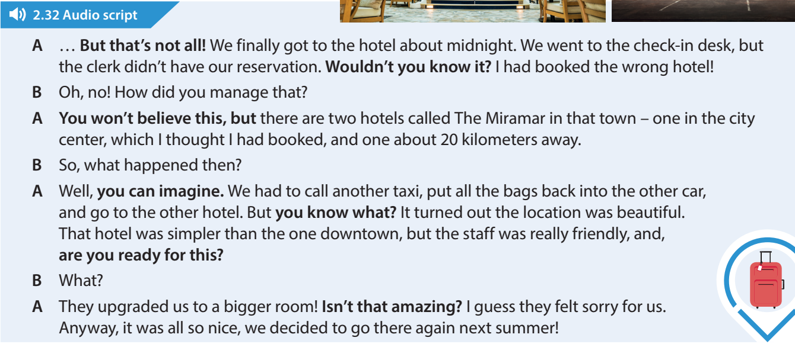

Slide 9
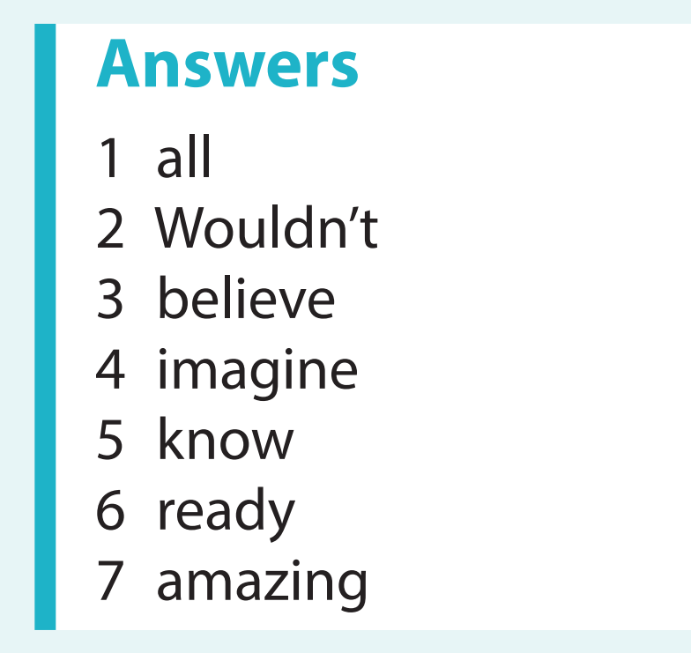

Slide 12
