Slide 1
Evolve 4C 10.4

Slide 6
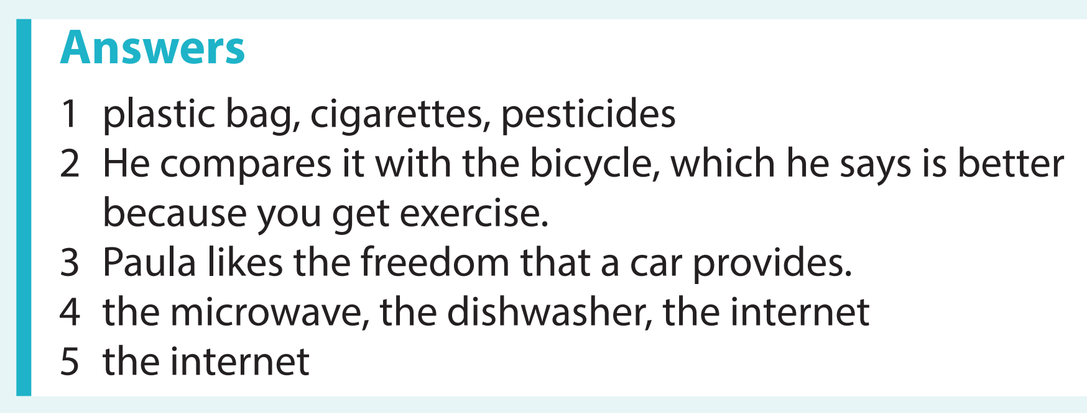

Slide 17
