Slide 1

Evolve 5A
Session 5

Slide 3
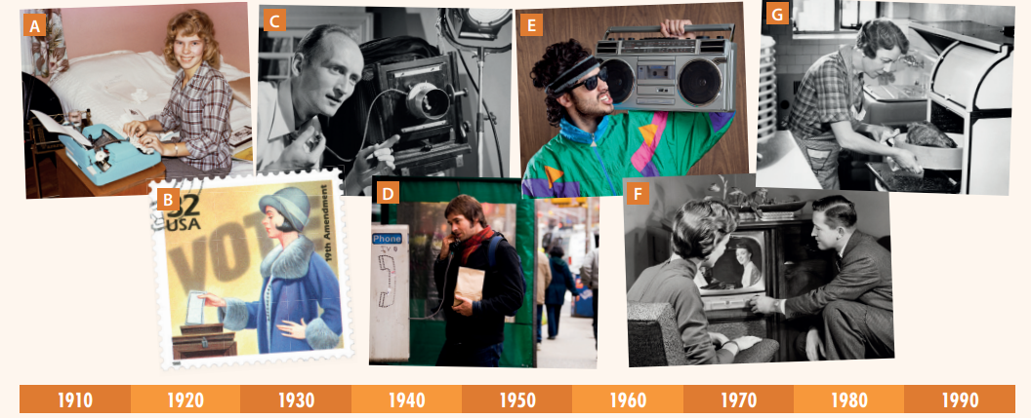

Slide 5


Slide 9

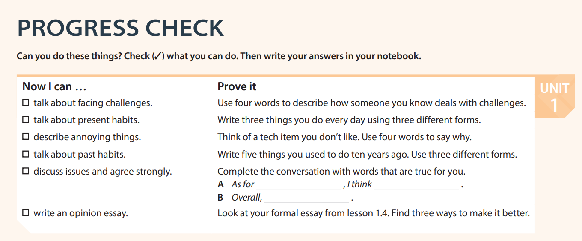

Slide 10


