Slide 1

Evolve 5A
2.5

Slide 3


Slide 4


Slide 7


Slide 8

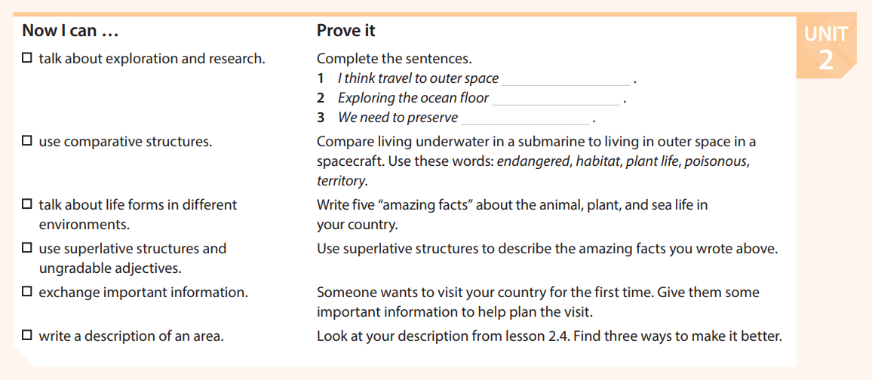

Slide 9


