Slide 1
Evolve 5A 4.3

Slide 5
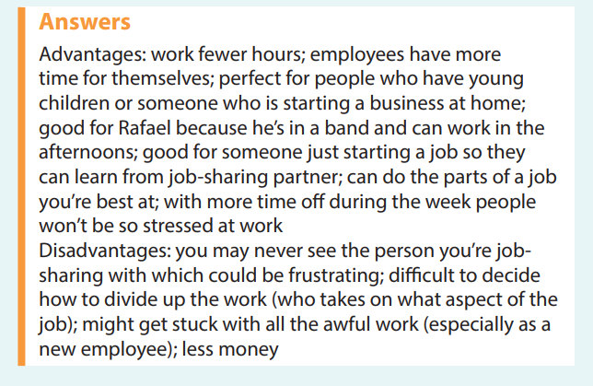

Slide 15
