Slide 1
EVOLVE 5B 5.3

Slide 18
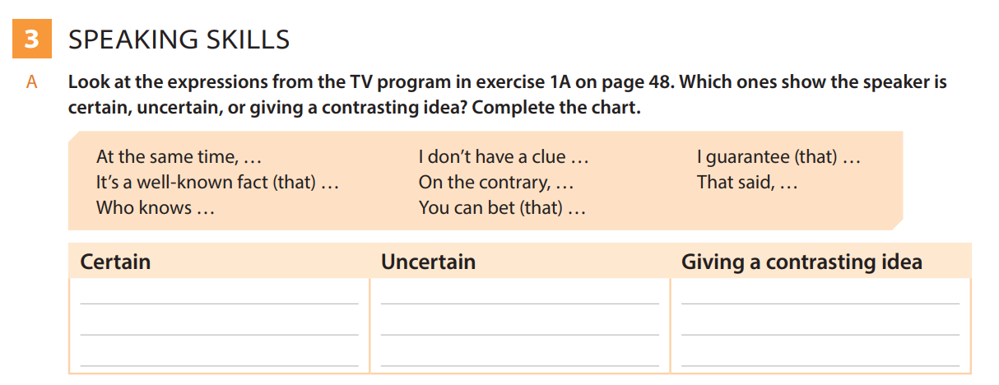

Slide 21
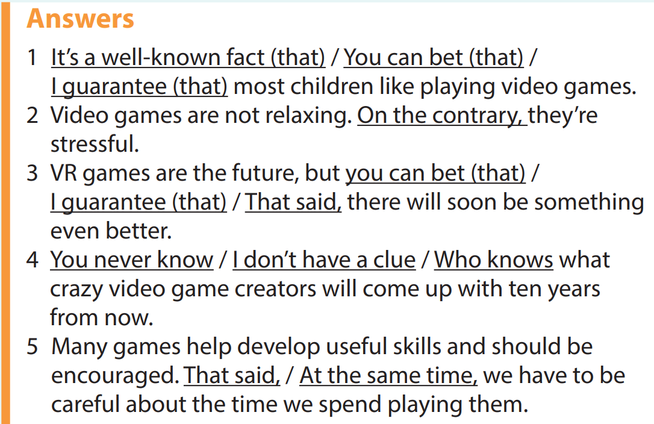

Slide 33
