Slide 1
EVOLVE 5B 6.1

Slide 4
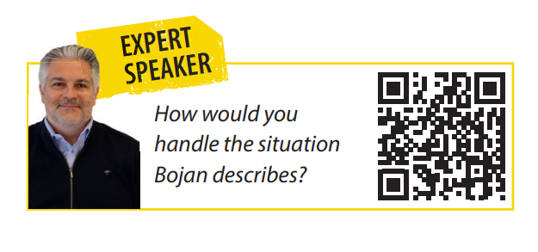

Slide 14
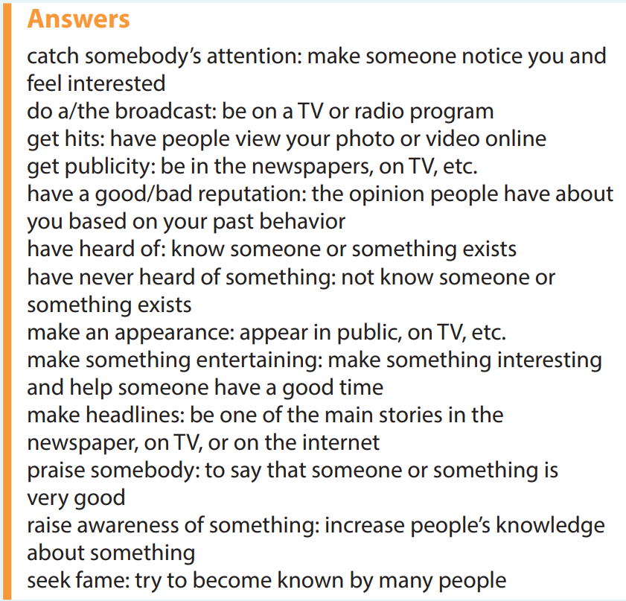

Slide 29
