Slide 1
EVOLVE 5B 6.3

Slide 2
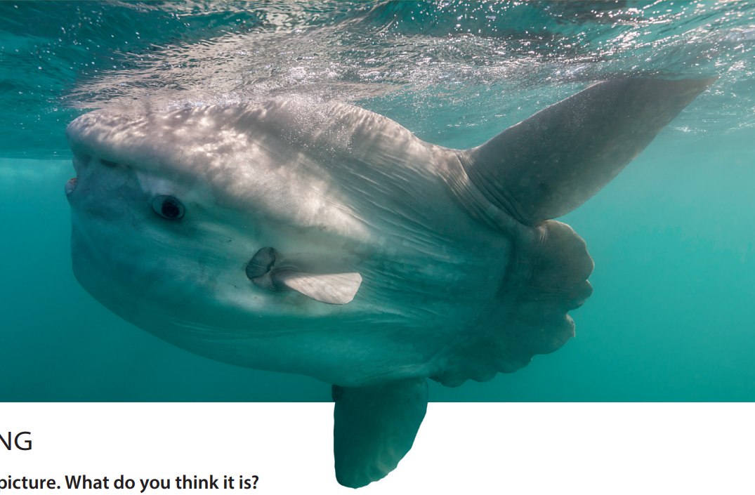

Slide 32
