Slide 1
EVOLVE 5B 7.5

Slide 2
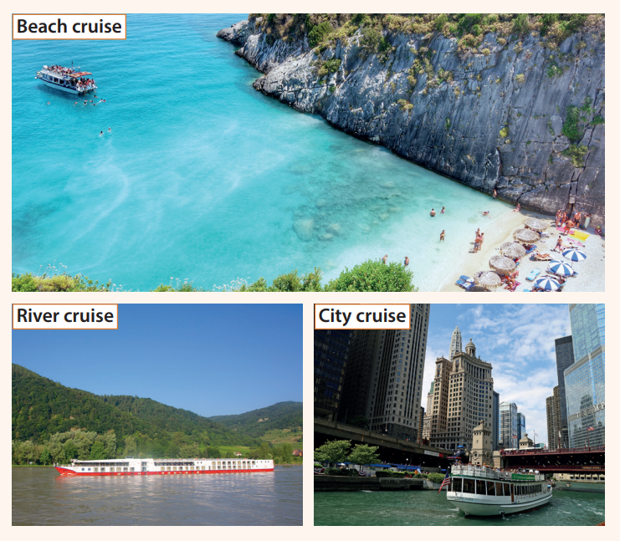

Slide 8
