Slide 1
Evolve 5C
9.1

Slide 9
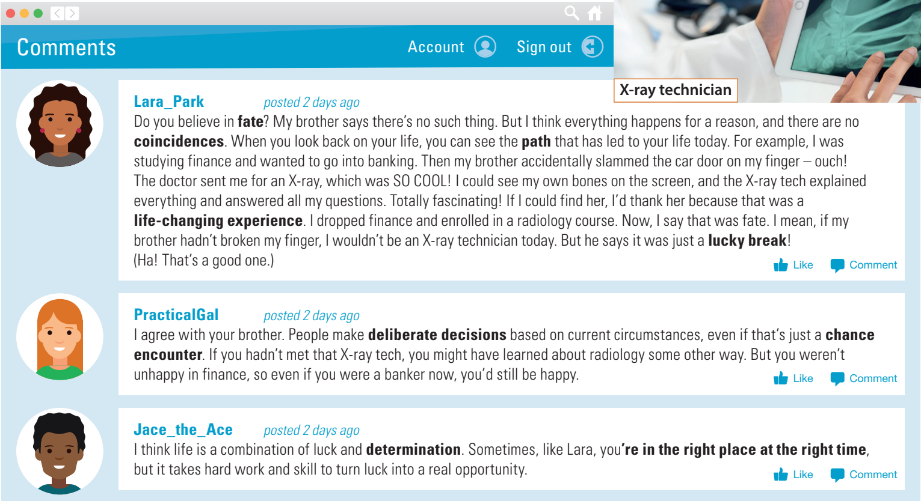

Slide 28
