Slide 1

Evolve 5C
9.3

Slide 2



Slide 3


Slide 4


Slide 5


Slide 7
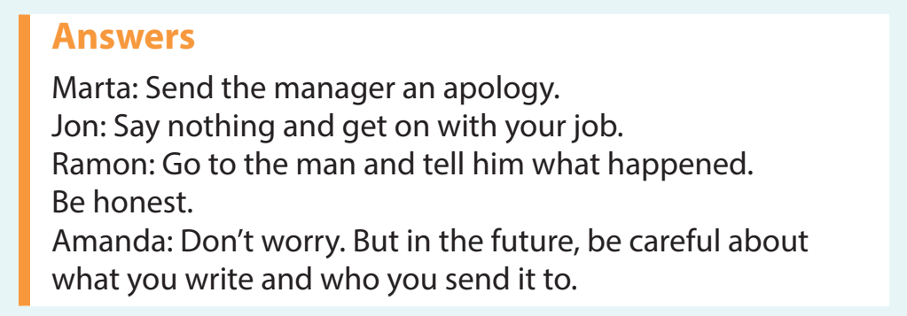

Slide 8


Slide 10


Slide 12


Slide 14


Slide 16
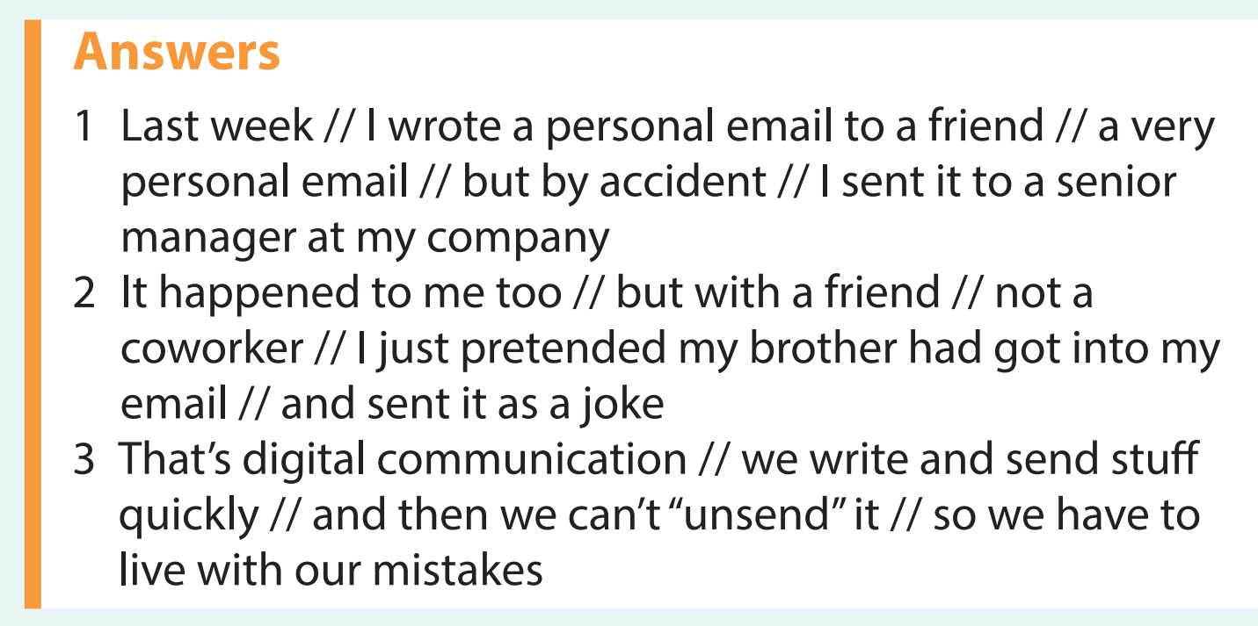

Slide 17


Slide 18


Slide 19
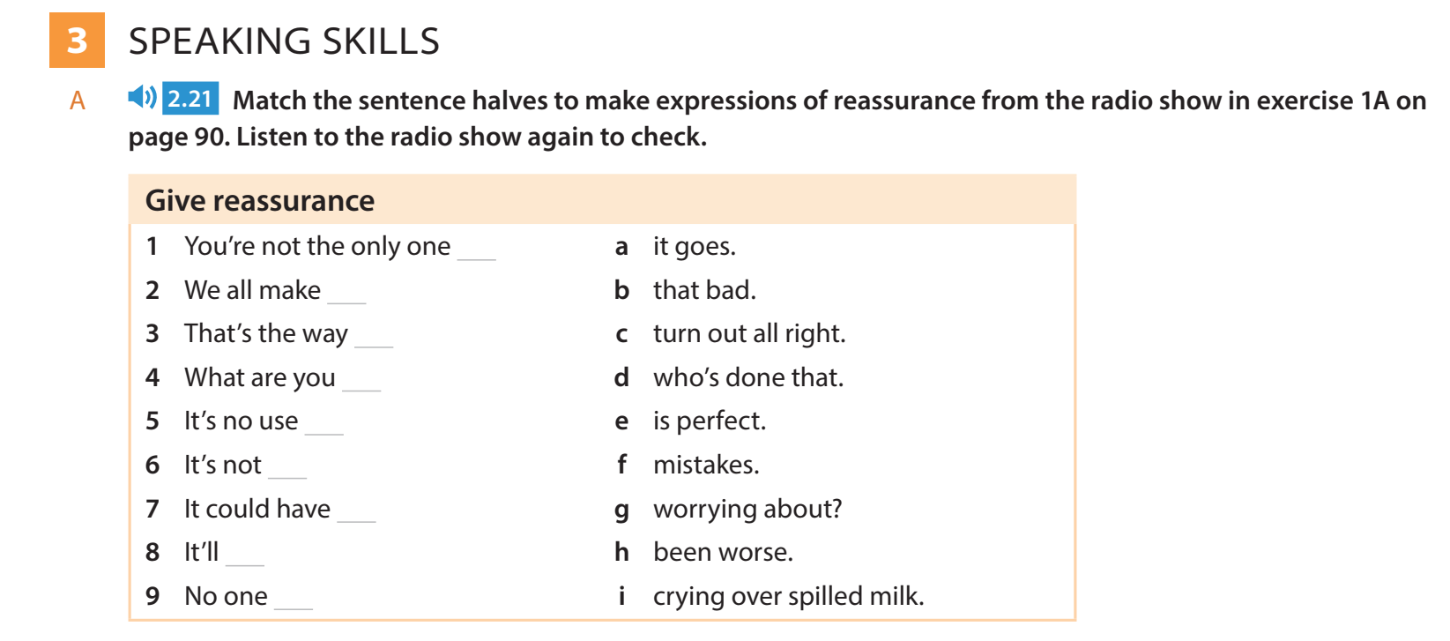

Slide 21


Slide 22
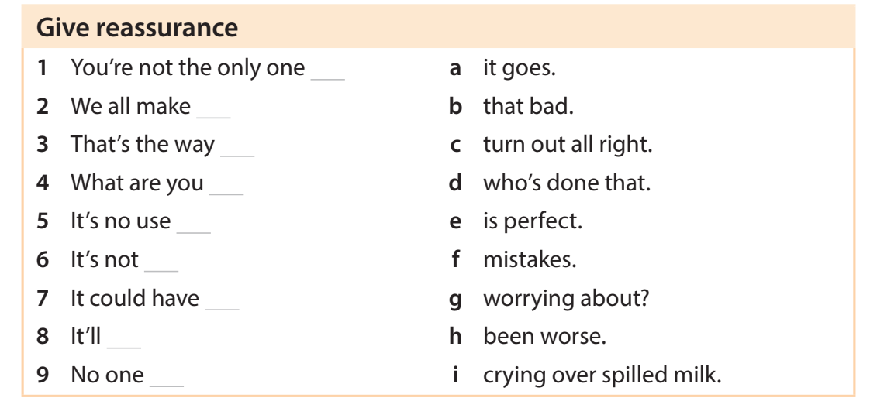

Slide 23
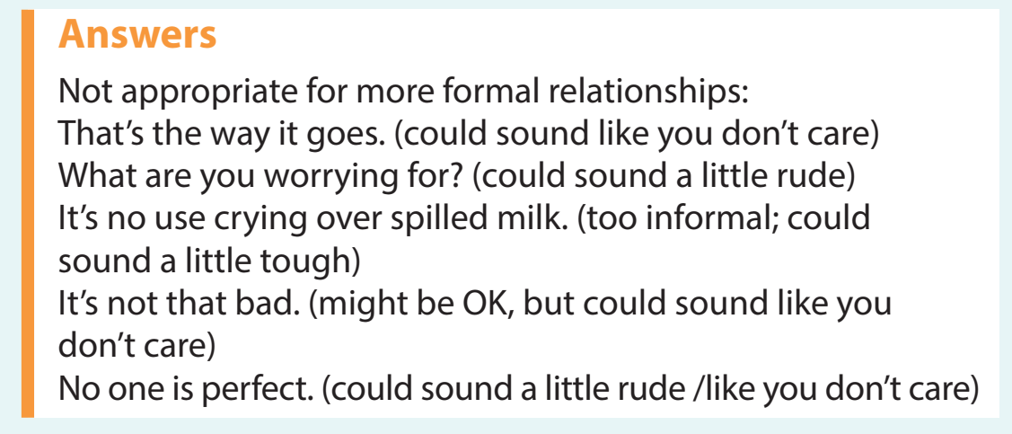

Slide 24



Slide 25


Slide 27


Slide 28


Slide 30
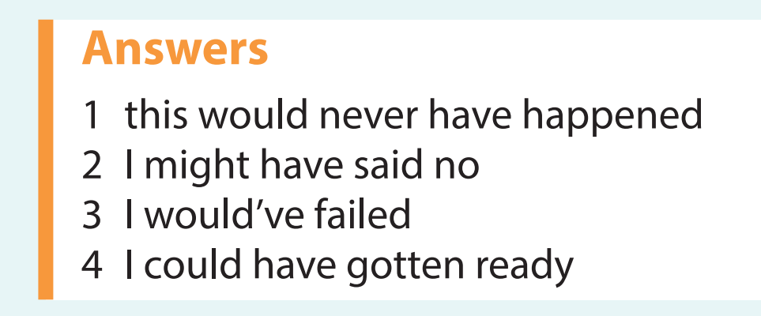

Slide 31


Slide 32
