Slide 1
Evolve 5C
10.3

Slide 5
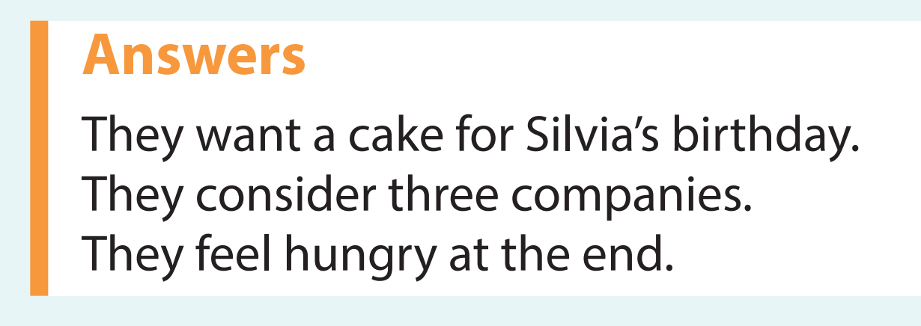

Slide 31
