Slide 1
Evolve 5C
10.4

Slide 4
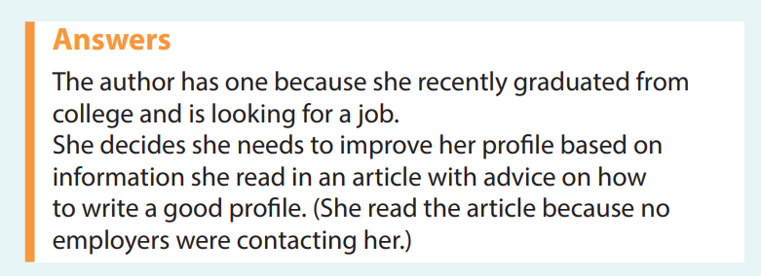

Slide 9
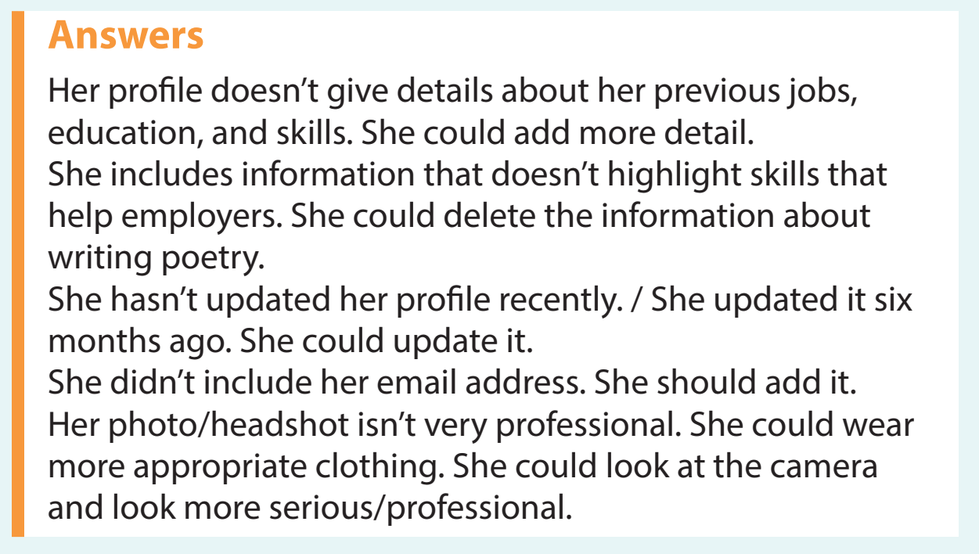

Slide 12
