Slide 1
Evolve 5C
10.5

Slide 2
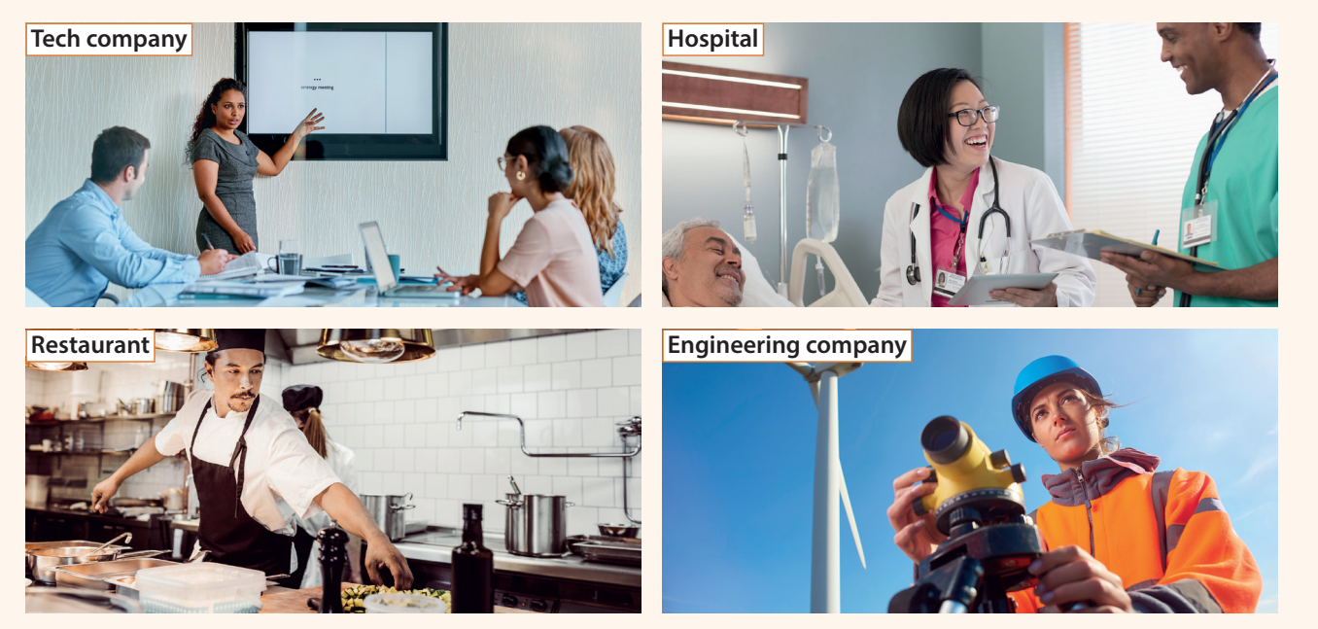

Slide 9
