Slide 1

Evolve 5C
11.1

Slide 2



Slide 4


Slide 5


Slide 6


Slide 7


Slide 8


Slide 9


Slide 12
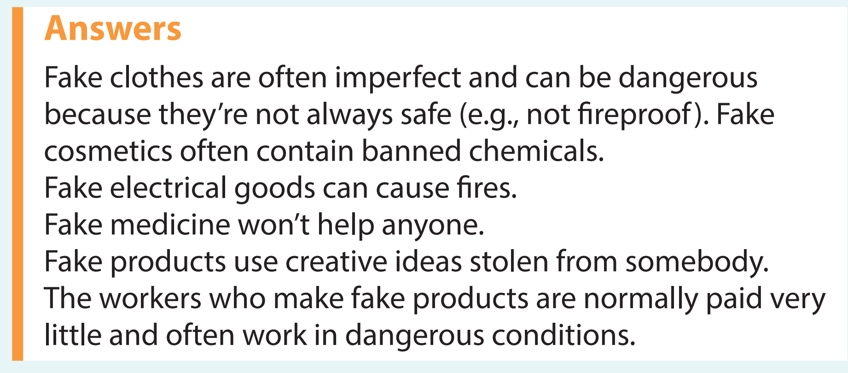

Slide 14


Slide 15


Slide 16
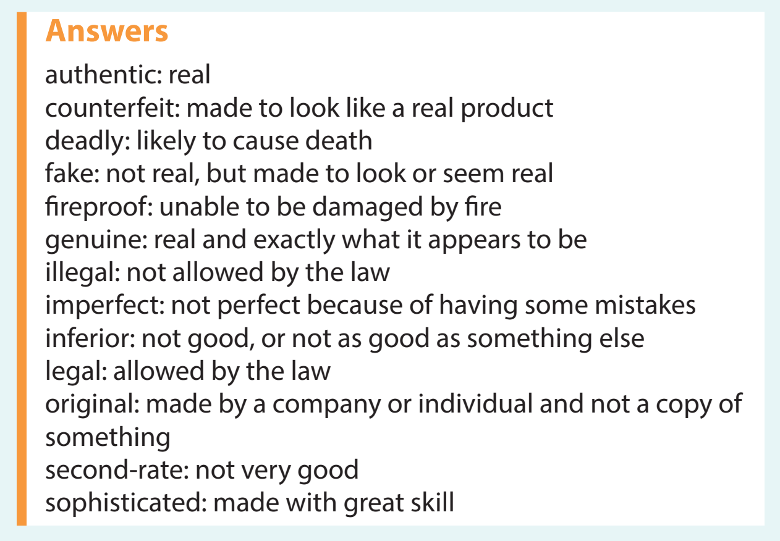

Slide 17
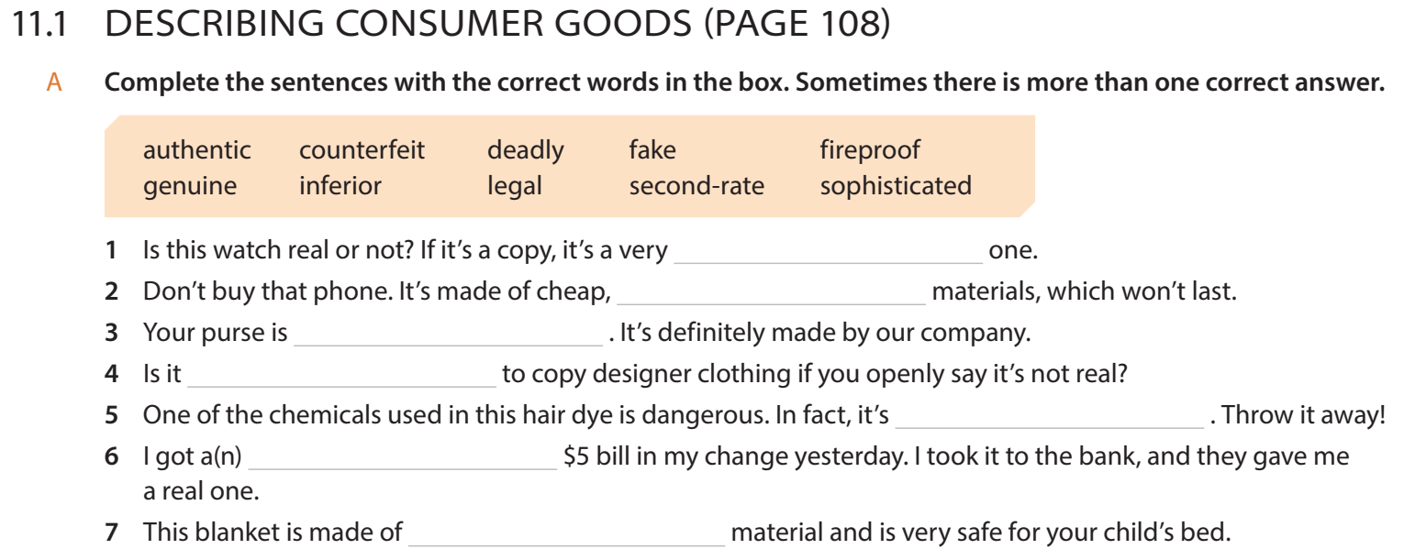

Slide 18
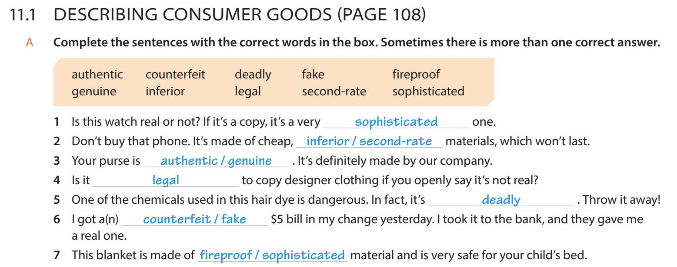

Slide 19


Slide 20


Slide 22
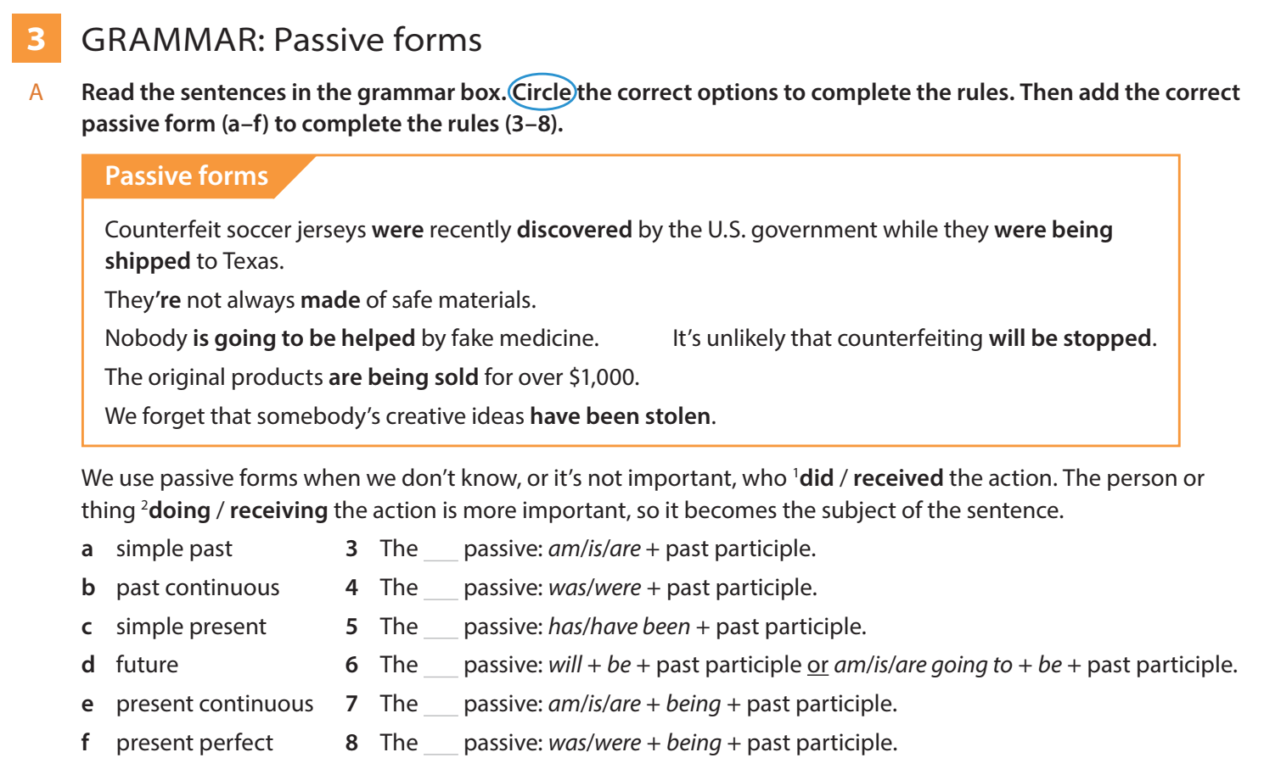

Slide 23


Slide 24


Slide 25


Slide 26


Slide 27


Slide 28


