Slide 1
Evolve 5C
11.2

Slide 9
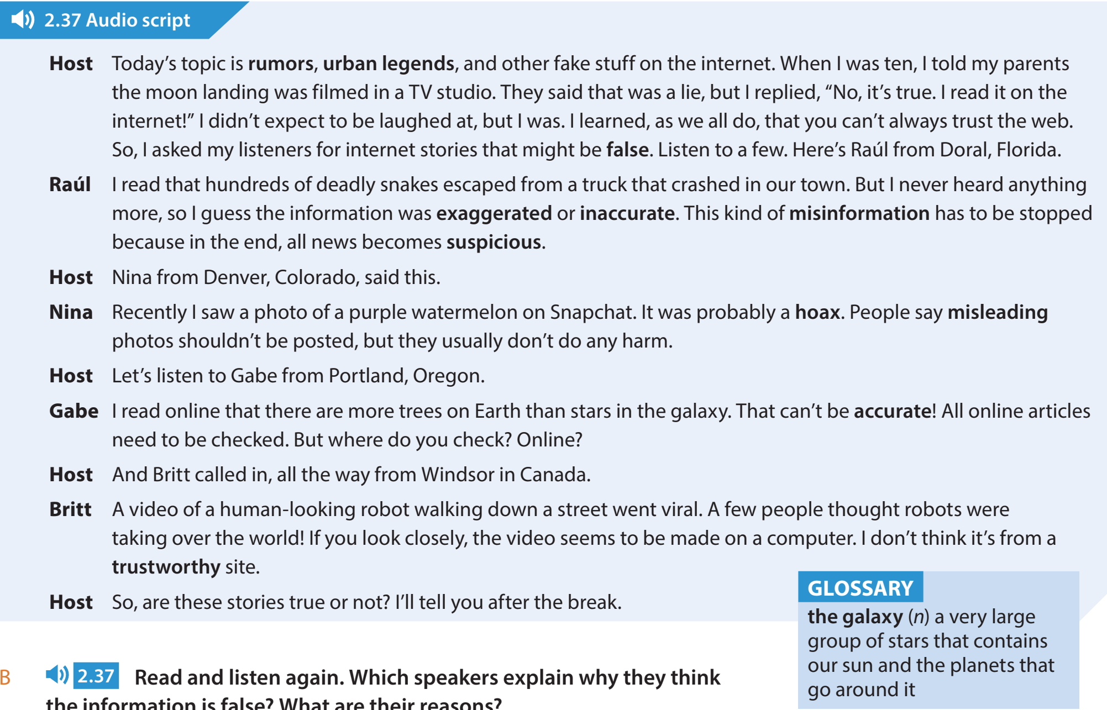

Slide 11
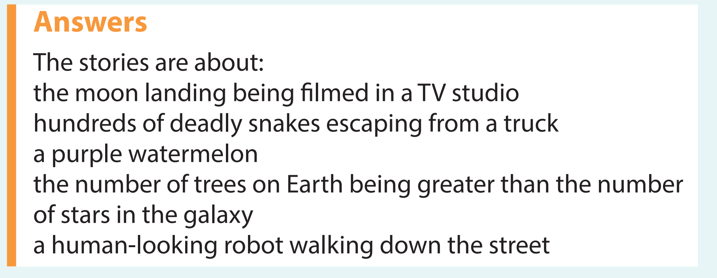

Slide 23
