Slide 1

Evolve 5C
11.3

Slide 2
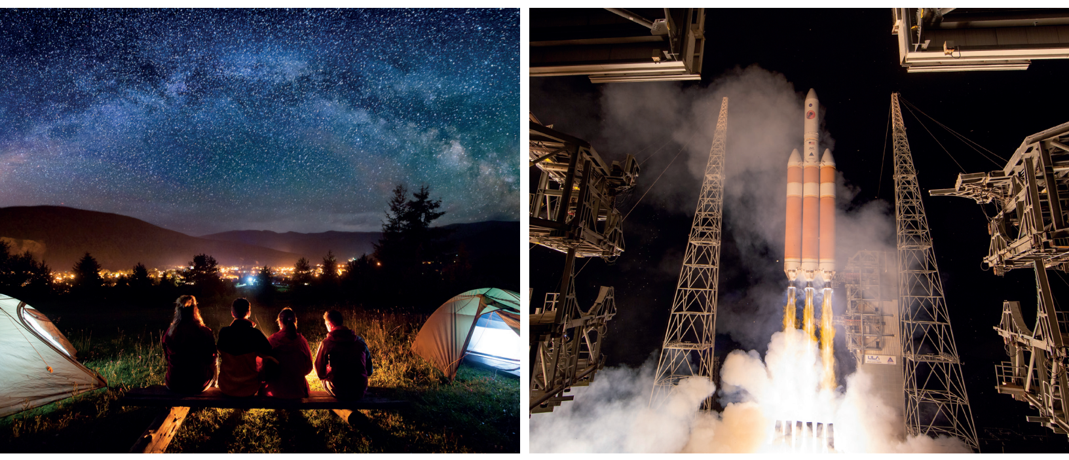

Slide 3


Slide 5


Slide 6


Slide 9
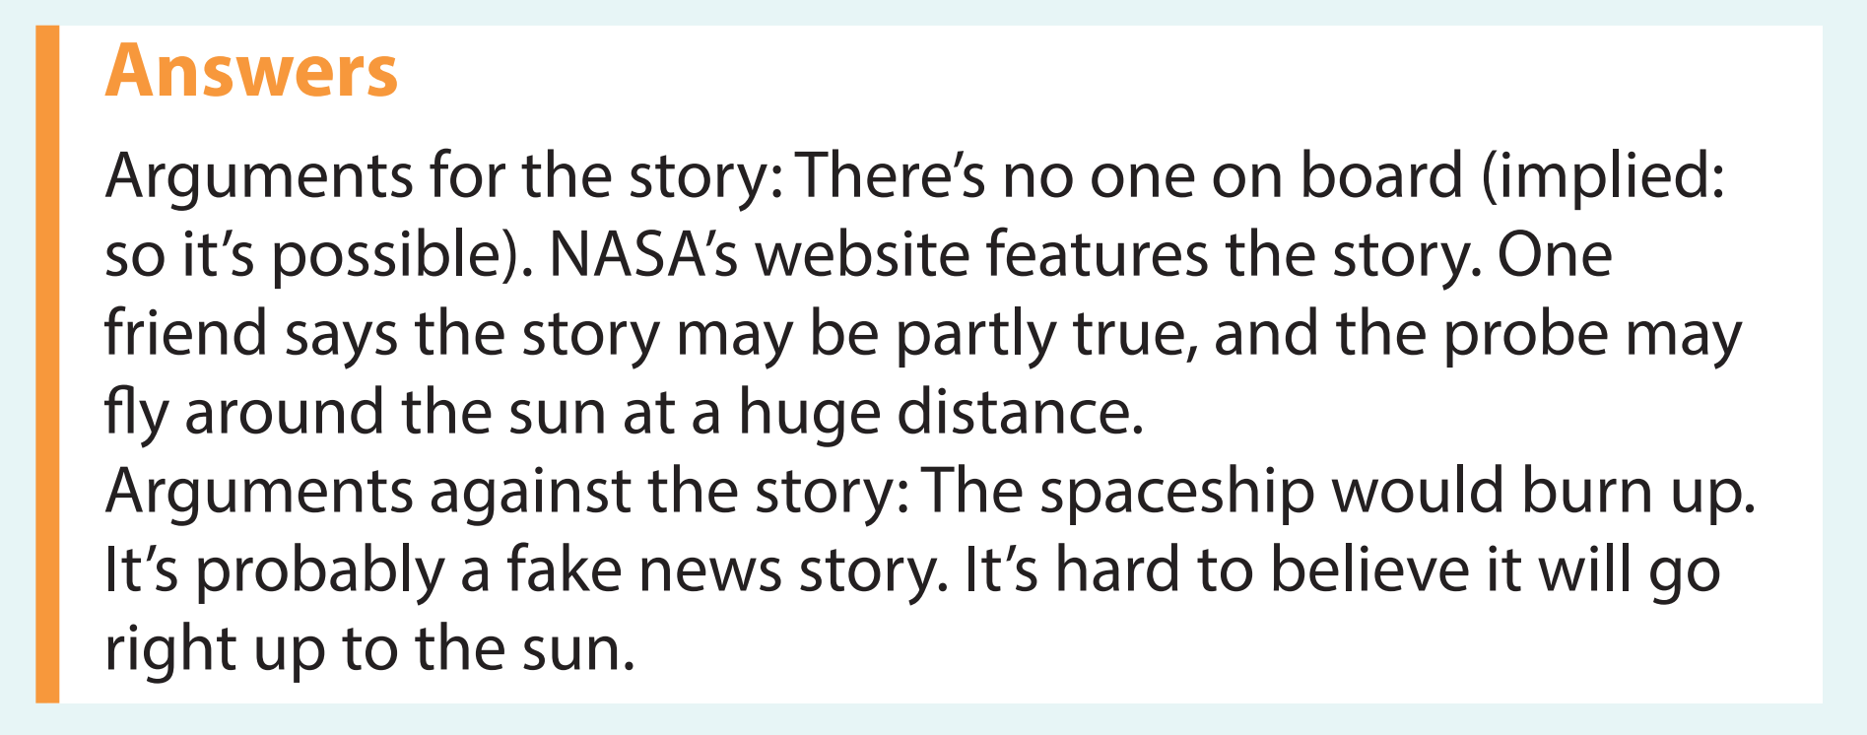

Slide 12
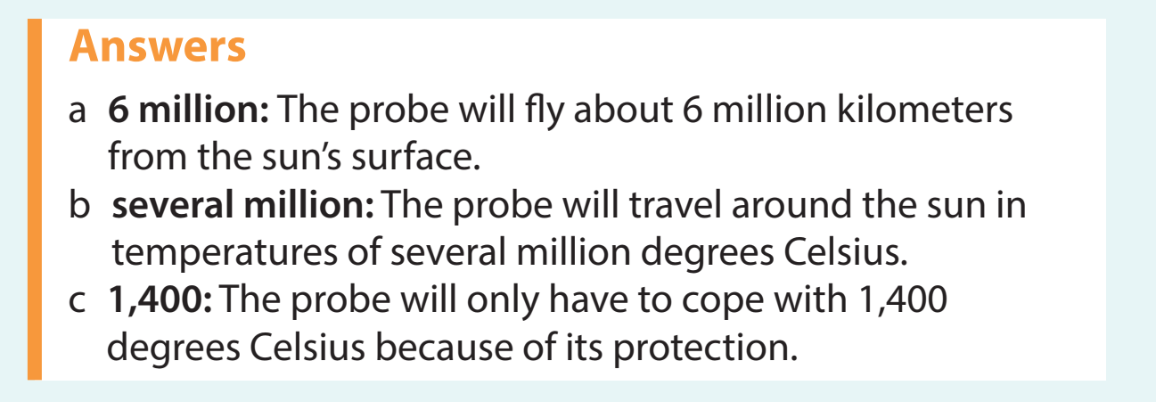

Slide 14
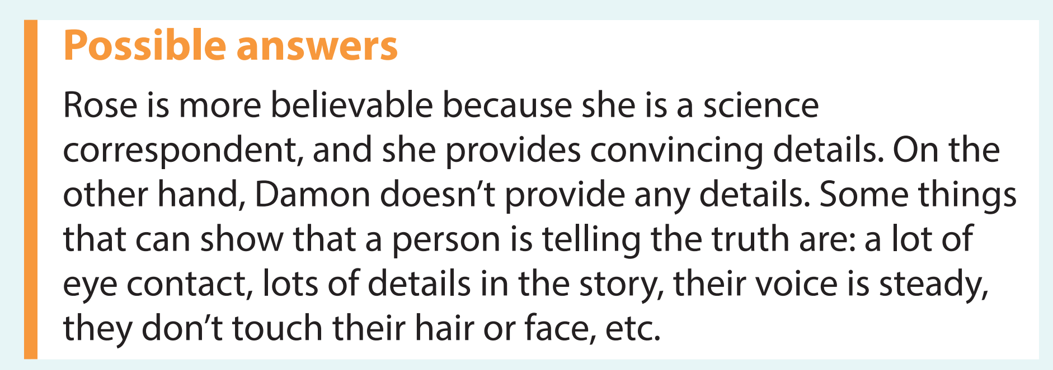

Slide 15


Slide 17


Slide 19
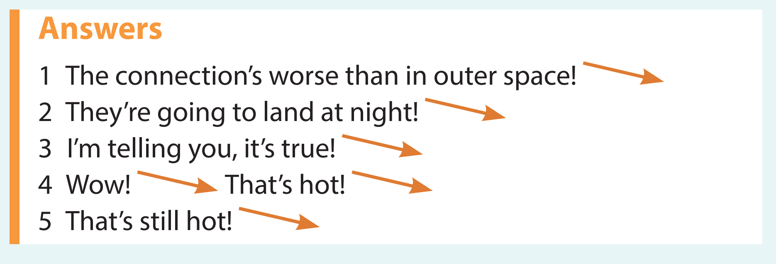

Slide 20


Slide 21


Slide 22


Slide 23
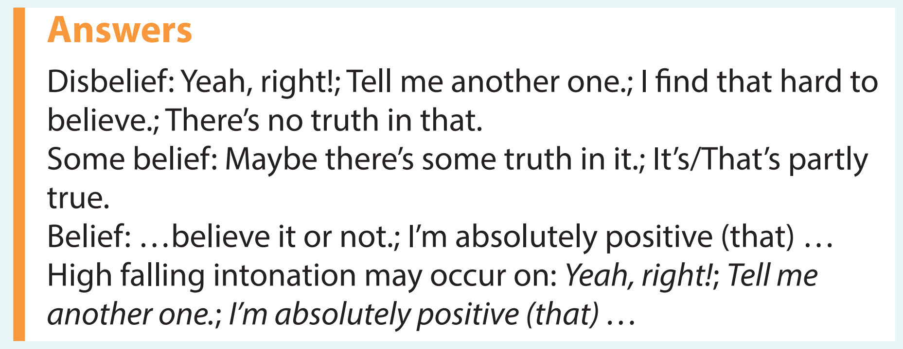

Slide 24


Slide 25


Slide 27


Slide 29
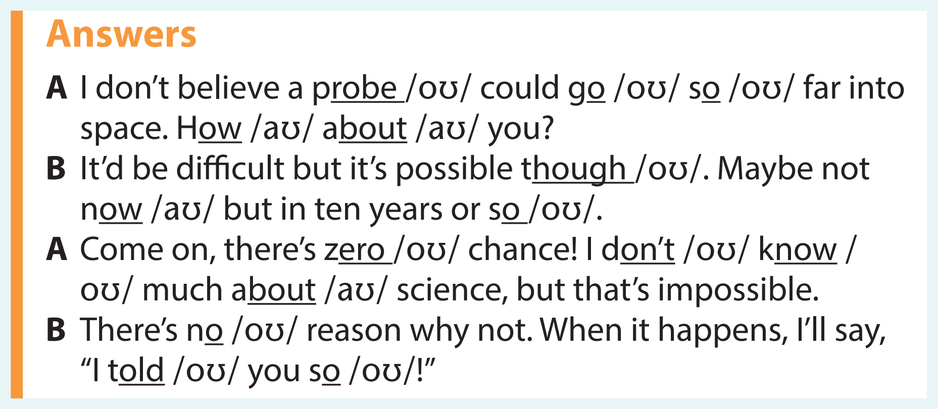

Slide 30


Slide 31
