Slide 1
Evolve 5C
12.5

Slide 10
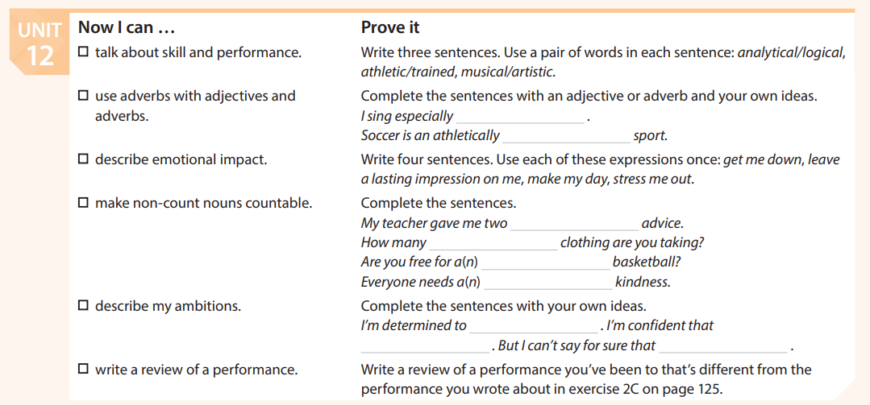

Slide 11
