Slide 1
EVOLVE 6A – 2.4

Slide 6
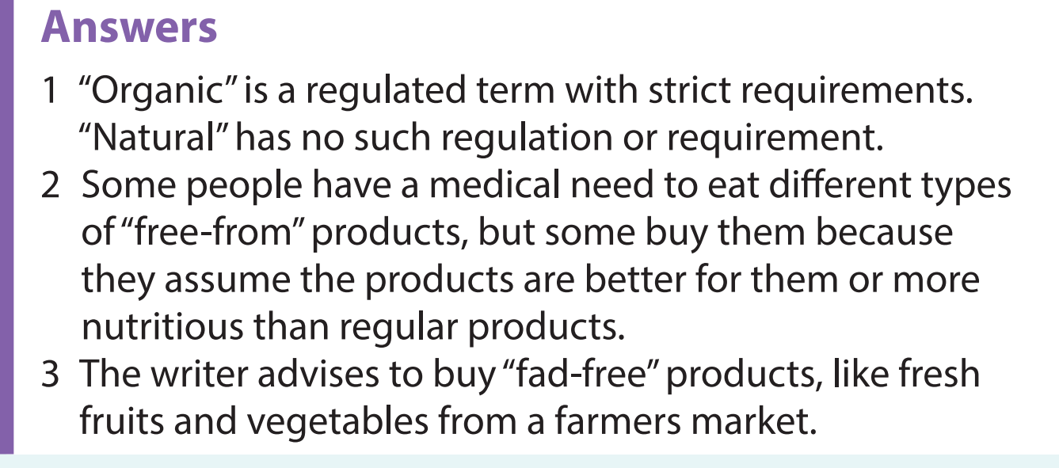

Slide 10
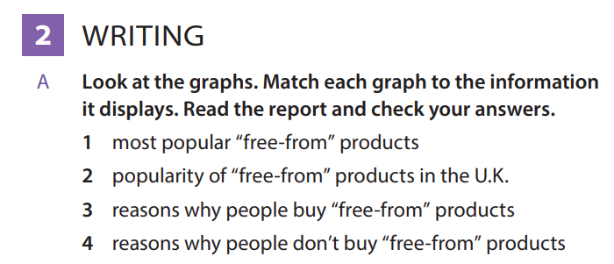

Slide 11
