Slide 1
EVOLVE 6A – 3.1

Slide 7
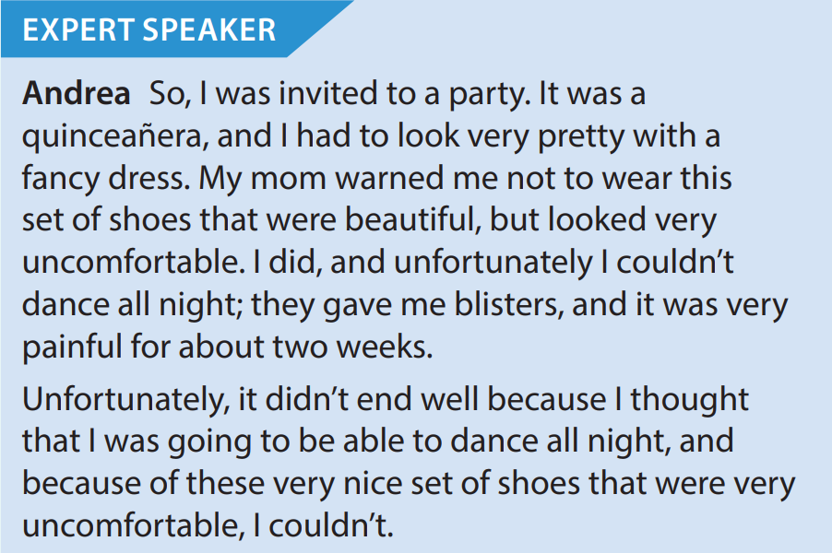

Slide 8
