Slide 1
EVOLVE 6A – 3.2

Slide 15
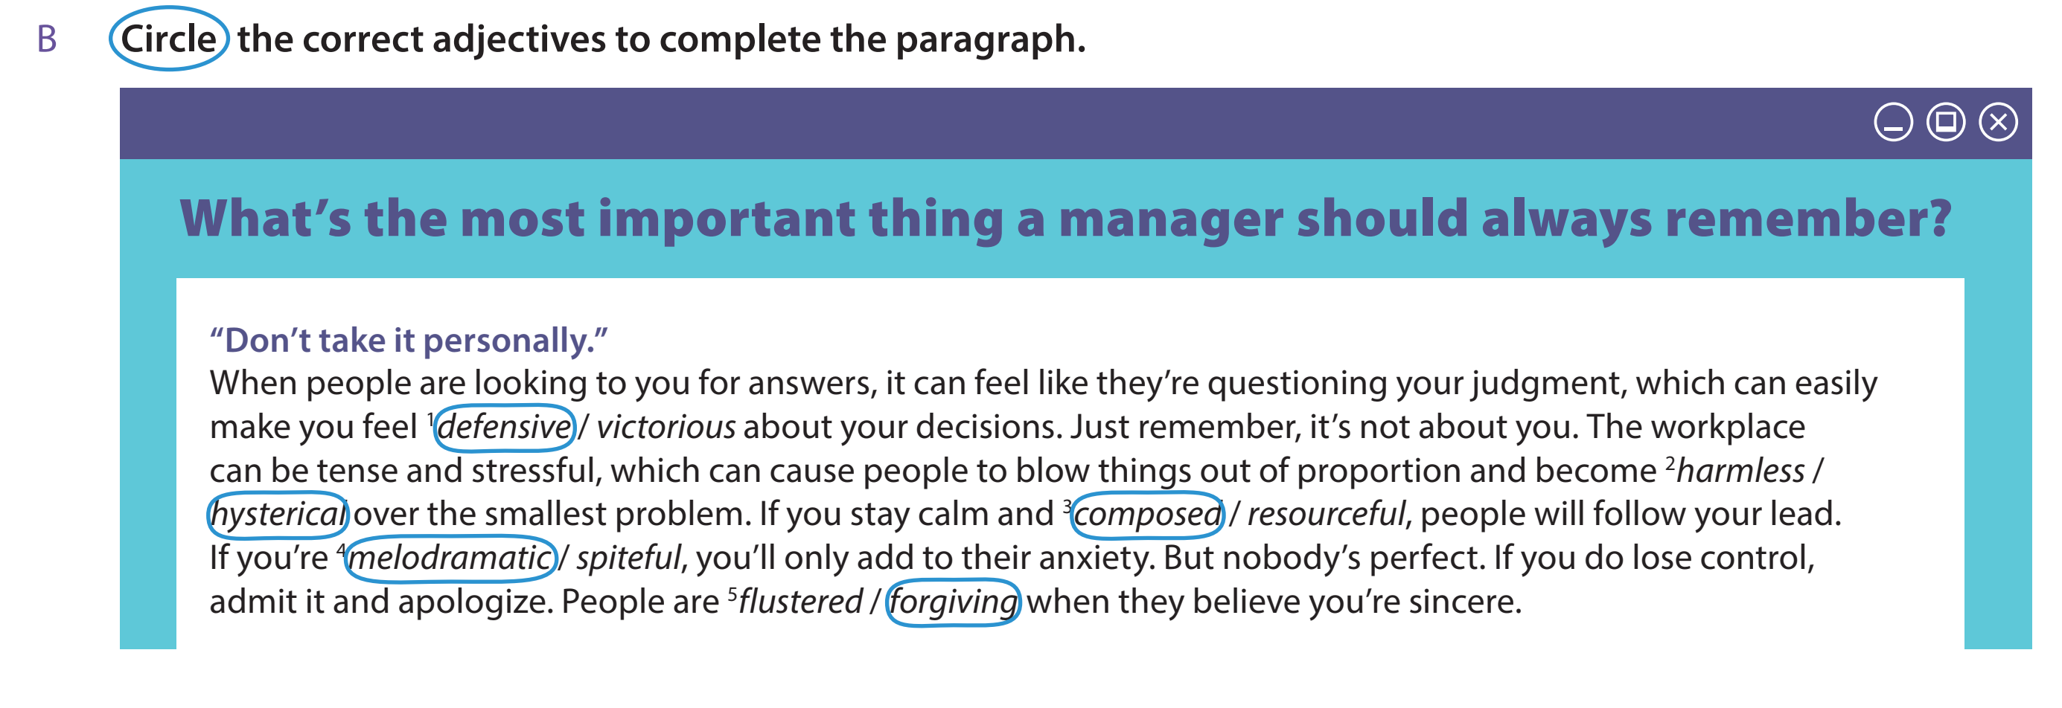

Slide 23
