Slide 1
EVOLVE 6A – 4.3

Slide 8
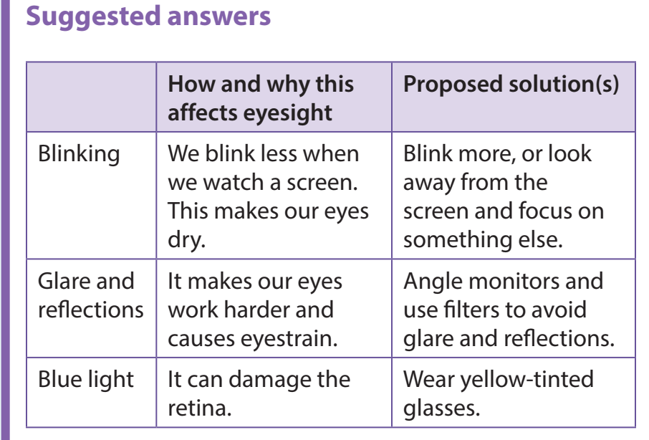

Slide 18
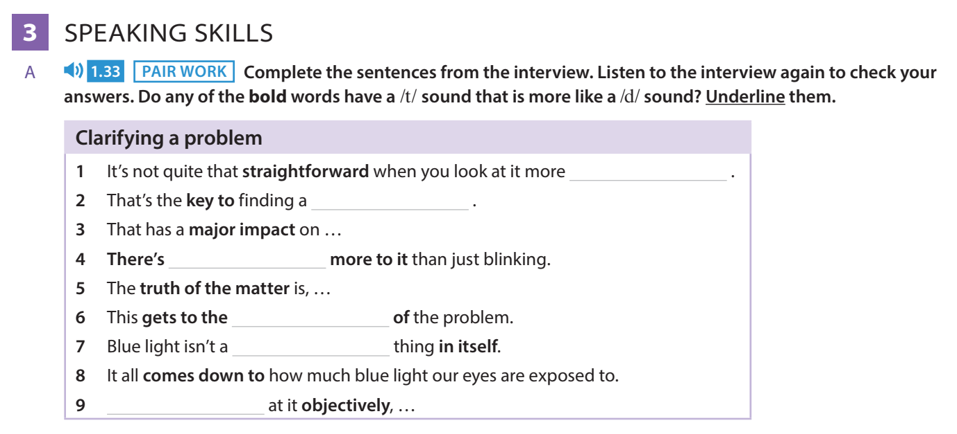

Slide 28
