Slide 1
EVOLVE 6A – 4.5

Slide 2
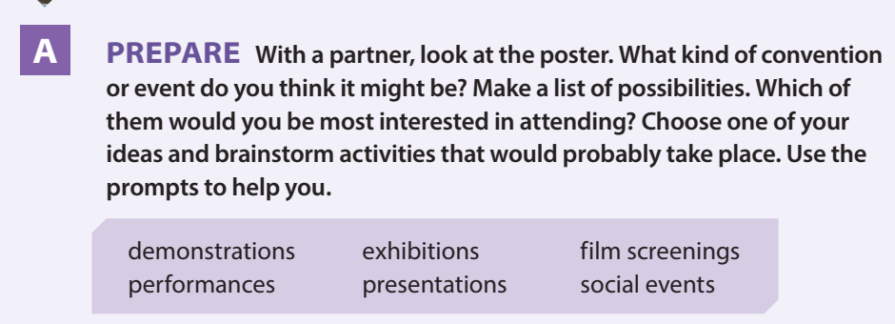

Slide 3
